Slide 1
Kent and Medway Dementia Service Improvement Programme
Dr Simon Lundy
18 May 2022

Slide 2
Programme Objective
People living with dementia and the people who care for them are able to access safe, timely, and high quality diagnosis and support.
The Dementia Programme has been established to deliver against the following objectives:
Improve the dementia diagnosis rate to 66.7% across Kent and Medway underpinned by workforce development and access to consistent, timely neuroimaging
Raise awareness of dementia and the benefits of a dementia diagnosis.
Develop public health messages to address risk factors in line with requirements of the NHS Long Term Plan, 2019 (eg what good is for heart, is good for the head).
Improve access to dementia coordination care coordination and access to appropriate post diagnostic support.
Provision of urgent support (home/care home) and support to care homes to enable people with dementia to remain in their usual place of residence.

Slide 3
Current Dementia Diagnosis Rates
ICP Rates
 | Dec-21 | Jan-22 | Feb-22 | Mar-22
DGS ICP | 59.4% | 59.5% | 60.2% | 61.5%
East Kent ICP | 57.7% | 57.3% | 57.6% | 57.4%
Medway/Swale ICP | 53.4% | 53.4% | 53.5% | 53.2%
West Kent ICP | 58.6% | 58.5% | 59.0% | 58.9%

Slide 4
Increasing the Diagnosis Rate
    Aim of the Project is to increase diagnostic capacity by:
    Improving KMPT’s pathway – aim for people to receive diagnosis within 6 weeks, where appropriate.
    Introduction of ten GPwERs.
    Encouraging the use of the DiADeM tool in care homes.
    Geriatrician diagnosis.
    Improving access to diagnostic imagining.

Slide 5
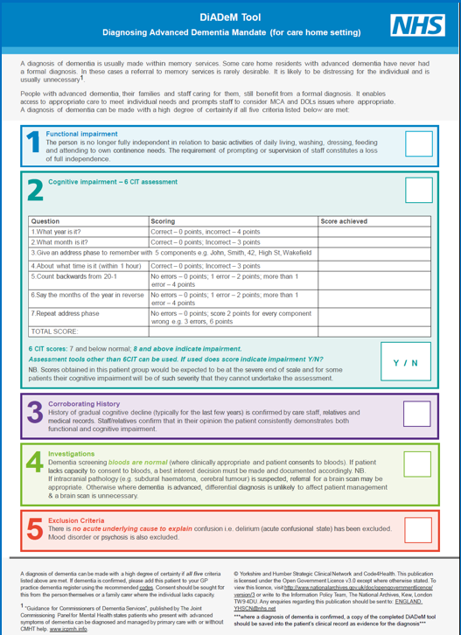
DiADeM Tool
5 parts:
1. Functional impairment
2. Cognitive impairment - uses 6-CIT or GPCOG
3. Corroborating history
4. Investigations
5. Exclusion criteria
DiADeM (Diagnosing Advanced Dementia Mandate) | Alzheimer's Society (alzheimers.org.uk)

Slide 6
Improving Support Post Diagnosis
Dementia Co-Ordinators – one per PCN.
  Aim is to provide consistent point of contact across the dementia pathway.
  KCC procurement of dementia post diagnostic support to ensure consistent offer across Kent.
  Ensuring access to support at times of crisis (people’s own homes and care homes).
  Supporting points of transition, eg from hospital to a care home.
  Improving end of life care, by ensuring the needs of people with dementia are recognised in the Kent and Medway End of Life Strategy.

Slide 7
Behavioural and Psychological Symptoms of Dementia (BPSD) Guidance
Acacia Sooklal
Lead Integrated Care Pharmacist
Kent & Medway CCG

Slide 8
Introduction
The term “Behavioural and Psychological Symptoms of Dementia (BPSD)” refers to the spectrum of non-cognitive and non-neurological symptoms of dementia, such as agitation, aggression, psychosis, depression and apathy.(1, 2)
The main symptoms include:
  • Delusions (believing things that are not true)
  • Hallucinations (seeing or hearing things that aren’t there, such as hearing strange voices)
  • Agitation or aggressive behaviour (distress, restlessness, extreme irritability or aggression
At least 80% of people with dementia experience BPSD.(2)
Depression and anxiety can be among the first symptoms of dementia, while other BPSD such as agitation and aggression more commonly occur later, especially as the person’s ability to communicate and influence their environment diminishes. (3)
These behaviours can be extremely stressful for the person and their family/and carers, and are often a reason for people with dementia being admitted into residential care.(2)
Appropriate treatment of BPSD can significantly improve the quality of life of the patient and their families.

Slide 9
Background
An audit was completed in GP practices linked to 14 Care homes to review the usage of Antipsychotic medication by residents.
The Audit identified antipsychotics prescribed, duration of treatment and whether reviews are in place.
The audit identified:
  •If anti-psychotics had been prescribed.
  •Duration of treatment.
  •If reviews were in place.

Slide 10
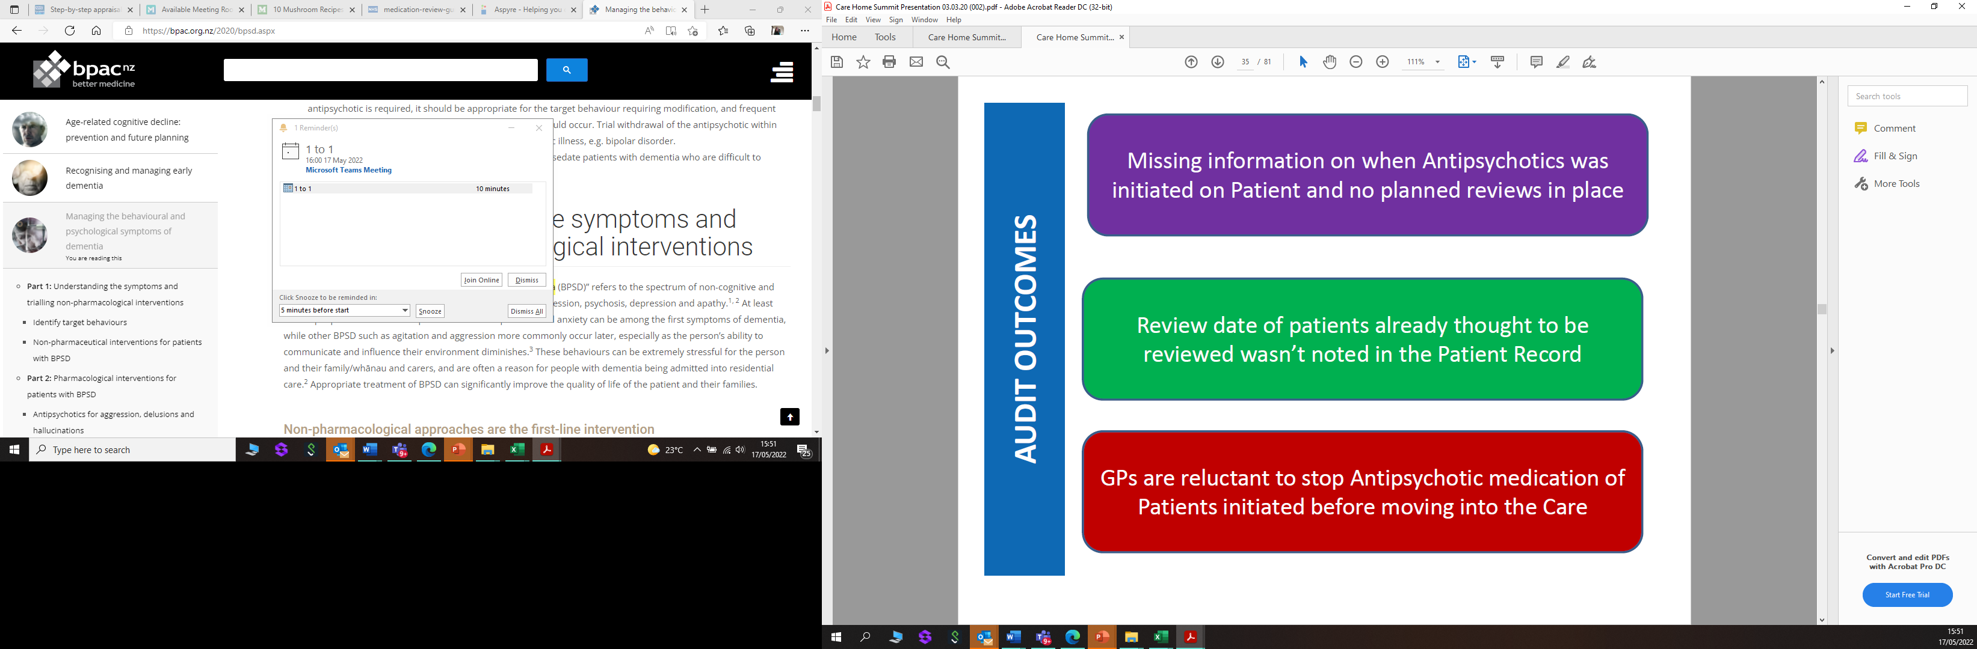
Audit Outcomes

Slide 11
Audit Outcomes
When Antipsychotics is initiated in secondary care (KMPT), review plan should be included in the discharge letter to GP. Suggested KMPT KPI-100% patients should have review plan in place
To collate some form of guidance for continued prescribing/deprescribing of Antipsychotics for GPs
Develop support/training for Care home staffs on alternatives to medication to manage behavioural symptoms (psychological or environmental options)- This will link in to the hospices to identify what trainings are available

Slide 12
BPSD Guidance
NICE guidance specifies that before starting any medication for distress in people with dementia, a structured assessment should be carried out to explore possible causes and address clinical or environmental factors, such an infection or pain.
If symptoms are very severe, or if non-pharmacological approaches have not worked, then medication can help to relieve BPSD and this may include the prescription of anti-psychotic medication, but these can have side effects which include severe physical symptoms, including stroke, heart attack, worsening of dementia symptoms or even death.

Slide 13
BPSD Guidance
The National Dementia and Antipsychotic Prescribing Audit 2012, found a decrease in the number of people with dementia prescribed antipsychotics in GP practices.
These reductions were related to a growing awareness about the risks of antipsychotics in people with dementia and of the need to adopt approaches based on the person’s needs (person centred care).
Because of the risks associated with the use of antipsychotics in dementia, the recommendation is that they should only be used for short period of time and should be reviewed regularly.
The use of antipsychotics in people with dementia has increased during the pandemic.
Data from NHS Digital reveal that the percentage of people with dementia in England prescribed antipsychotics has risen from a stable 9.4-9.5% in the 8 months prior to March 2020, to 10% in 30 April 2020.
Notes:
The use of antipsychotics in people with dementia has increased during the pandemic. Data from NHS Digital reveal that the percentage of people with dementia in England prescribed antipsychotics has risen from a stable 9.4-9.5% in the 8 months prior to March 2020, to 10% in 30 April 2020. This is largely attributed to prescribing in care homes for individuals, who have struggled to understand the restrictions placed upon them by the pandemic or who have a delirium caused by Covid-19.

Slide 14
BPSD Guidance
The BPSD guidelines have been produced to provide guidance on the prescribing and withdrawal of anti-psychotic medication for people with dementia.
The guidelines are intended to provide support to clinicians in the review and withdrawal of these medications where appropriate.
A significant number of GPs are already engaged in doing, so it was not intended that they should create additional work for GPs/primary care.
NICE recommends that antipsychotic medication should only be used in people with dementia if they are:
  At risk of harming themselves or others.
  Experiencing agitation, hallucinations or delusions that are causing them severe distress.
  If antipsychotics are used, they should be tried alongside other activities to try to help their distress.
NICE also suggests that, before starting treatment with antipsychotic medicines, the benefits and harms should be discussed with the person and their family members or carers.
Review of mediation should be done at least every 3 months.

Slide 15
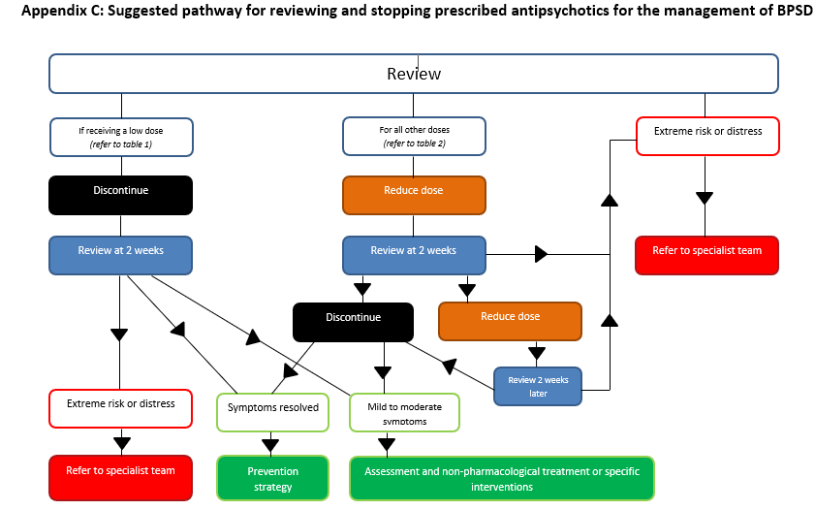
BPSD Guidance
The Guidance includes:
Guidance on tapering down the does of commonly used antipsychotics
Patient information for carers and relatives about the common effects of stopping antipsychotic medication.
Suggested pathway:

Slide 16
Next Steps
Whilst it is recognised that before anti-psychotic drugs are prescribed psycho-social interventions should be tried to de-escalate any behaviours, many care homes do not have the appropriate skills to do this which means that there is a need for training for these homes and this is currently being planned for later 2022.

Slide 17
Thanks for listening
Any Questions?

