Slide 1
What is an Advanced Clinical Practitioner?
Notes:
Introduce self

Slide 2
Purpose of Workshop
To provide an Introduction into the Advanced Clinical Practitioner Role, to support individuals, Supervisors, Practices and PCNs to develop a clearer understand about the Advanced Clinical Practice role.

Slide 3
Our intention is to…….
Give a General Overview of the national picture for Multi -professional ACP’s
To give an overview for all concerned of the HEE Multi professional Framework For ACP’s-What for/Who for/How to use?
To give an introduction to the ACP Role – what does this really mean? Defining features/level of practice.
Guidance and definition of Multi-professional level of Advanced Clinical Practice.
To understand the obligation of ACP Managers /Supporting employers etc regarding the support and training of ACP’s
To understand the governance and process requirements when developing new ACP roles.
To understand the Organizational needs/Obligations regarding ACP’s (Governance and Strategy)
To understand the plan moving forwards of the use of Advanced Clinical Practice Development Groups
Questions and next Steps

Slide 4
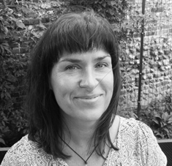
Sarah Goodhew
Sarah Goodhew – Lead for the SE Region Faculty of Advancing Practice, Health Education England.
An experienced nurse with over 30-years clinical service in the NHS. Specialising in cardiology, cardiothoracic surgery, acute medicine, and critical care where I worked for several years at advanced level.
Senior service lead and education positions also held.
A positive advocate and champion for human factors and interprofessional team working, always seeking out opportunities to learn from, about and with each other.
A visiting lecturer and simulation faculty member at Brighton & Sussex Medical School.
Project lead for advanced clinical practice in a large acute teaching hospital on the South Coast before joining HEE in Kent, Surrey & Sussex in 2017 as lead for advanced practice within the workforce transformation team.
Working in partnership with Organisations, Trusts, Primary Care Hubs, HEIs, commissioners, trainees and practitioners working at an advanced level to enable a greater awareness and understanding of this level of practice, the support and education preparation required, enabling structures and governance for these types of roles.
Through curious conversations and guided workshop facilitation helping stakeholders identify where advanced clinical practice roles may be best placed within services and across systems to have the biggest impact for local populations.
Successfully appointed as Lead for the South East Region Faculty of Advancing Practice in November 2020, currently building the core team and our wider faculty infrastructure.

Slide 5
Advanced Practice
The National Picture
Sarah Goodhew
Faculty of Advancing Practice Lead
Health Education England – South East Region

Slide 6
Background
Need for a coordinated approach……….

Slide 7
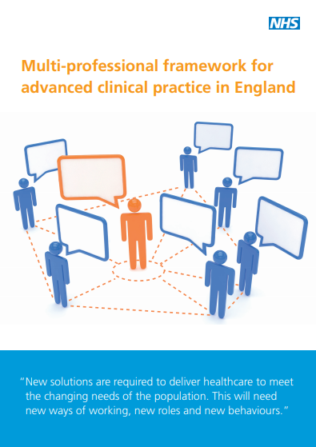
HEE multi-professional framework for advanced clinical practice in England 2017
Definition
Core capabilities
Key principles for implementation
Advanced level practice manifests itself in different types of role, dependent upon the needs of service, characterised by the level of practice once trained
https://www.hee.nhs.uk/our-work/advanced-clinical-practice/multi-professional-framework

Slide 8
National Advancing Practice Agenda
The Centre for Advancing Practice
Programme accreditation
Independent Portfolio Route (IPR)
Supervision
Credentials
Consultant level practice
Regional AP Faculties
Frameworks in development

Slide 9
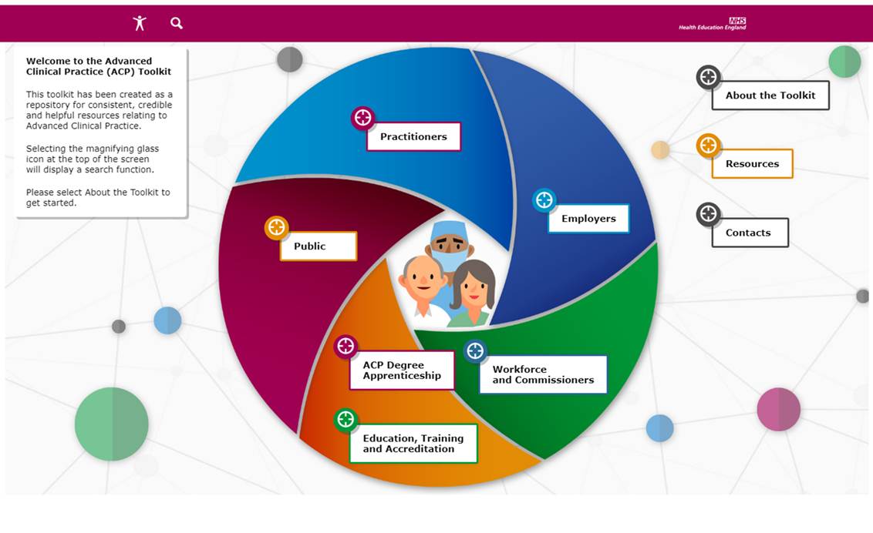
HEE Advanced Practice Resources
Advanced Practice Toolkit
Reports & Publications
Impact of COVID-19 upon and implications for advanced and consultant practice
Workplace Supervision for advanced clinical practice: An integrated multi-professional approach
News, views & getting involved
Conference recordings – ‘Taking Centre Stage’
Newsletter sign up
FAQs
https://www.hee.nhs.uk/our-work/advanced-clinical-practice

Slide 10
Regional Advancing Practice Faculties

Slide 11
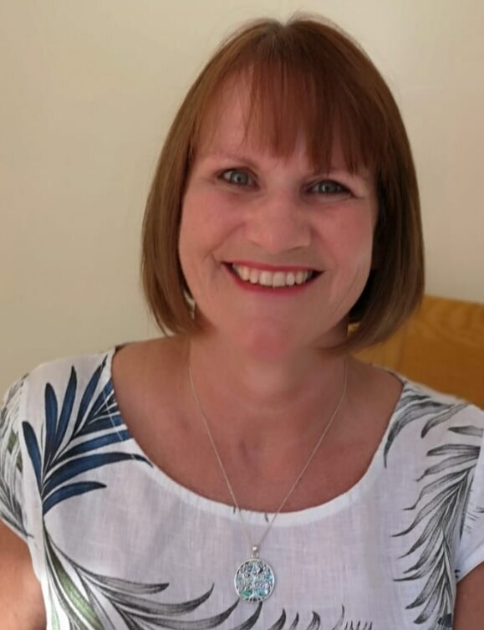
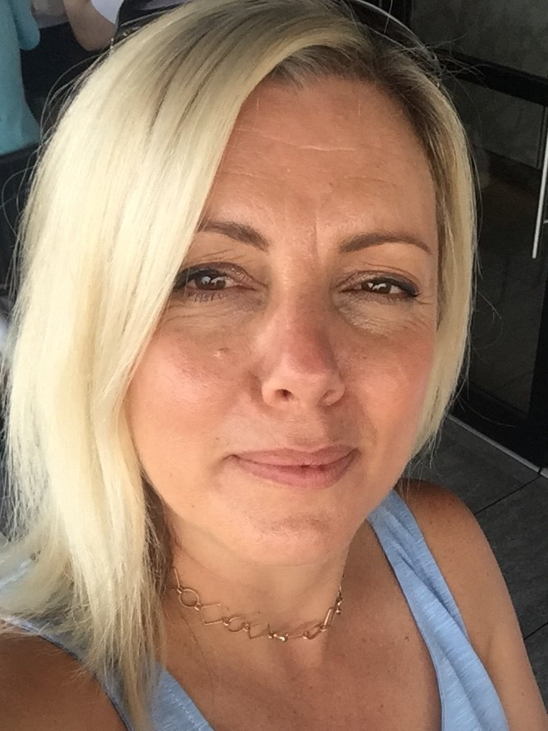
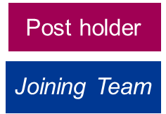
SE Region Advancing Practice Faculty
Sarah Goodhew, Faculty Lead
Sandie Skinner, Project Manager (p/t)
Tina McGrath, Project Support Officer (p/t)
Kate Cheer,
Administrator Support
Donna Poole,
Executive
Sponsor
Heather Nisbet,
Supervision and Assessment Lead
Emmie Baker-Larner,
Project Manager

Slide 12
HEE South East Region

Slide 13
Staying Connected
HEE advanced practice website:
https://www.hee.nhs.uk/our-work/advanced-clinical-practice
Email:
acpenquiries.se@hee.nhs.uk
Twitter:
@AdvCare_goodS

Slide 14
Q&As

Slide 15
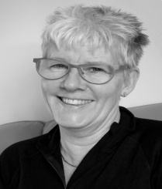
Allie Carter
30 years NHS Clinician and Clinical Lead - Physiotherapy ( Latterly 11 years Head of Children’s Physio GSTT NHS Foundation Trust
Advanced Clinical Practitioner in Neonatal Intensive Care for 20 years
3 Years CQC Inspector
11 years Independent Project Lead and Change Leadership Consultant & Trainer.
Projects have inc. Therapies & Nursing Modernisation ( Sussex Community Foundation Trust )
ACP Mapping ( SCFT )
HEE project lead for ACP multi professional Survey,
Various ACP evaluation pieces
Training and developing Advanced Practitioners in order to map them to , and help them achieve the correct level of practice to be aligned to the HEE Multi professional Framework for Advance Clinical Practitioners.

Slide 16
Introduction to the Implementation of the Advanced Clinical practitioner Role
Allie Carter
Independent Training Consultant

Slide 17
ACP Intro Session – Key points included.
Multi professional Framework-What for/Who for/How to use ?
Overview of this for all concerned
To give an introduction to the ACP Role – what does this really mean ? Defining features/level of practice.
Guidance and definition of Multi-professional level of advanced Clinical Practice.
Obligation of ACP/Managers regarding support and training of ACP’s.
Developing new roles.
Organizational needs (Governance and Strategy)
ACP Development Group Model

Slide 18
Learning Objectives
Briefly define the HEE multi-professional Framework for multi-professional ACP’s.
Discuss the multi-professional ACP Role.
Describe the obligations of the ACP manager's role regarding support and training of ACP’s.
Describe the governance and process requirements when developing new ACP roles.
Discuss the use of Action Learning Sets to support ACP students and potential students at Sussex Partnership NHS Trust
Discuss the national drivers for investing in the ACP role.

Slide 19
Introduction
The national picture for advanced clinical practice is comparable to the situation within many healthcare settings; roles have been developed to predominantly meet service needs in acute care, within an emergency department or theatre setting,
This situation has been recognised at a national level and led to the release by Health Education England of the ‘Multi-professional framework for Advanced Clinical Practice in England Nov 2017’
This framework provides guidance on ACP roles both established and in development and how they should be governed.
Each Speciality is gradually working on taking the framework and creating a Core capability document relevant to that speciality.( e.g. Mental Health, PC Nursing ,Paramedic etc)

Slide 20
Future Developments- New ACP Roles- Drivers for Change
DRIVERS - National
• Long Term plan and more recently the people plan
• Shortage of junior doctors
• NHS funding pressures, activity/acuity increases
DRIVERS - Local
• Medical rota gaps
• High locum spend
• Limited career progression choice at Bands 6/7/8
• Difficult to recruit/retain experienced AHPs, nurses
& midwives

Slide 21
Benefits - National & Local
Improved quality, safety, continuity of patient care
Experienced staff remain in clinical/patient-focused roles
Enhanced staff engagement, retention and innovation in service development
Reduction in high locum/agency spend
Enhanced inter professional learning opportunities
1.https://www.england.nhs.uk/five-year-forward-view/ and https://www.england.nhs.uk/2017/03/next-steps-on-the-five-year- forward-view/
2.http://www.bbc.co.uk/news/health-35667939
3.https://www.nuffieldtrust.org.uk/files/2017-03/evidence-to-the-house-of-lords-committee.pdf
4.An evaluation of the implementation of Advanced Nurse Practitioner (ANP) roles in an acute hospital setting. JAN 2014
5.Transforming Nursing Roles Developing Advanced Practice In NHS Scotland June 2016 – summary and recommendations
6.Development and implementation of non-medical practitioners in acute care. BJN, 2016, Vol 25, No 20
7.Impact of advanced non-medical practitioners in emergency care: protocol for a scoping study. BMJ open 2017 ACP roles

Slide 22
The National framework - Overview
Gives clear guidance for:
Advanced Clinical Practitioners
The Four Key pillars of Practice
Supporting Employers/Organisations & Primary care.
Support and Supervision recommendations
Training - specific to ACP Level of practice
Governance requirements of organisations
Developing New roles guidance

Slide 23
What is an ACP ?
ACP definition from the national framework:
“Advanced Clinical Practice is delivered by experienced registered healthcare practitioners. It is a level of practice characterised by a high level of autonomy and complex decision-making. This is underpinned by a master’s level award or equivalent that encompasses the four pillars of clinical practice, management and leadership, education and research, with demonstration of core and area specific clinical competence. Advanced Clinical Practice embodies the ability to manage complete clinical care in partnership with patients/carers. It includes the analysis and synthesis of complex problems across a range of settings, enabling innovative solutions to enhance patient experience and improve outcomes.”
(Health Education England, 2017)

Slide 24
ACP vs ENP/ESP/Clinical Specialist – Differences (Allie Carter SCFT Scoping Project)

Slide 25
Advanced Practice Pillars – To aid competency development.

Slide 26
Governance

Slide 27
Organizational/Employer Governance Considerations
The following which is lifted from the 2017 Multi-professional framework, clearly articulates just how important this is and what must be considered
‘The governance of advanced clinical practice roles is vital to their success. Good governance involves inclusive, participative decision making with clear lines of accountability and responsibility. Policies and processes need to be in place and must include the evaluation of effectiveness, impact, ongoing sustainability, and responsiveness.
Organisations must ensure that robust governance arrangements surrounding all types and levels of practice, are in place prior to the establishment of new roles, and these must be enhanced and strengthened for existing ones.’

Slide 28
In Summary Organisations / Trusts/Practices should be working towards having :
Support and Supervision
Access to role specific training and development
A policy for advanced Clinical practitioners
There is an ACP lead at Organisational ,PCN or hub level,
Active discussion is occurring at board level of the ACP agenda
Individuals are being supported in regular attendance at forums off multi-professional advanced clinical practitioners.

Slide 29
Supervision & Support (The Centre for Advancing Practice – Workplace Supervision for Advanced Clinical Practice www.hee.nhs.uk )
Employers must ensure regular review and supervision is carried out by those who are appropriately qualified to do so.
Governance arrangements must also ensure that those who support and review practice are also developed, facilitated and supported to carry out this role.
The development of health and care professionals to enable them to operate at the level of advanced clinical practice, requires three elements within the workplace:
• development of competence and capability
• supervision and support in the work place
• assessment of competence and capability

Slide 30
Development of New Roles Services with Advanced Clinical Practitioner involvement.
Imperative this is done comprehensively
Create pathways and guidance in organisations that are part of policy to ensure this is equitable and consistent

Slide 31
What Kind of Development is this?/What are the drivers for Change?

Slide 32
What’s recommended when developing new ACP Roles ? An example from scoping at SCFT –paper attached to invite
The Scoping at SCFT Identified the Possibilities for Future Role Development
The exercise itself raised awareness of the ways in which ACP’s can enhance and lead services.
Each post will require the pack developed being used and appropriate input from the Lead for Advanced Clinical Practice/professional Lead be encouraged. This pack includes
What Kind of Development? Checklist
Drivers for Change
Differences ACP/ESP
Framework for Developing new roles
Competencies for Entry, Experienced and Advanced practitioner Level
Planning workforce and Governance
Supervision Guidance
Template for Planning new service Principles
Example JD
HEE document
Attached in email with presentation

Slide 33
ACP profiles - outlines that may inform new role Choice & hence role development needs are dependent on how the role is set up
Job plans / role needs must be considered
A role may vary in the amount of time required for each pillar
You may need a more Research oriented role so this will mean more time may be allocated to this pillar
Similarly, with leadership and education
Its possible depending on service needs, individuals' profile and practice/organizational needs that no two roles will look the same.

Slide 34
NB. The next slide gives a Nursing example, but the concept/ such a Framework is equally transferable for all of the other multi-professional ACP’s you will think about employing into future posts. ( The SCFT ‘developing future posts’ document has a flow chart for decision making too)

Slide 35
Framework for Developing New Nursing Roles – SEHD 2005 www.scotland.gov.uk NB

Slide 36
Service Evaluation- Employers and ACP’s will need to consider and evaluate/measure
Consider and evaluate the impact of advance clinical practice roles on service user experience and outcomes and on service delivery and improvement objectives.
What objective outcomes are expected from the advanced clinical practice role?
• When will these outcomes be achieved and how will these be measured pre and post implementation?
• What risks and unintended consequences might there be to the introduction of this role and how may they be mitigated against?
• What resources and support are required for role development and succession planning?
• Is workforce optimised to ensure clinical and financial benefits are maximised?
• How will on-going competence and capability be reviewed and enabled?

Slide 37
Summary-HEE Multi-professional framework for advanced clinical practice in England
This framework defines and sets the standards for the level of advanced clinical practice. It establishes the capabilities for this level. It also sets out a clear standard of education.
Guidance is given to employers on decision making processes that must be introduced so that they understand when and how this level of practice should be implemented.
Primary consideration is given to where this level of practice would be best placed in individuals’, families’ and carers’ journeys for greatest impact upon the planning of the workforce.
Employers responsibilities regarding processes and governance are set out.
The level of advanced clinical practice needs to be widely explained and understood, both by the rest of the workforce and by the public.
Those practising at the level of advanced clinical practice, and those aspiring to this role, need to be supported by their employers and everyone working around them. This will encourage innovative ways of working in modern teams.

Slide 38
How do we get to this place of ACP and Manager alignment to the MP framework?
Alignment to the Framework for Supporting Employers and ACP Staff
One way here at East Kent and Medway is theimplementation of ACP Development Groups.

Slide 39
One way –ACP Development Groups
Having worked on the HEE national ACP survey in 2019 which involved ;
Extensive engagement - workshops
Multiple calls
Support in the process of implementing and aligning staff to the HEE MP Framework.
Identified
We are on a journey
All organizations are in different places
There needs to be support to help Orgs/Practices/TH’s and managers to get staff to recognize and be able to align to the MP Framework.
Recognized Orgs and managers needed help to align to the Governance requirements of the MPF

Slide 40
ACP Development Groups(Akin to Action Learning sets)
Initially Developed
Face to face Dev groups/workshops, 5 sessions ( ALS Style)
General intro and 4 x 3-hour sessions for each pillar
Now ( Covid -19 dictated)
Online
9 x 2-hour sessions ( intro and 2 sessions per pillar)
How ? / What ?
Experiential, some tools, questionnaires, case studies, sharing from their daily working
Overview of the requirements of each pillar

Slide 41
Aim
Primarily
Assist managers/supporting employers in helping staff comply with the HEE ACP multi-professional framework. ( i.e. alignment to the four pillars
Help managers identify who they have and what the needs are ( gaps ) for future supervision and training /support of ACP trainees and existing staff.
Added bonus
Assists ACP’s to see where they align to the framework and what their gaps are
Gives appropriate training and peer support.
Each CCG/TH has commissioned the shape of the groups dependent on local demands/agendas but this fits with an overarching National Agenda.

Slide 42
Who for ?
Potential ACP’s
Trainee ACP’s on programs and others
Existing ACP’s
Lead ACP’s
Staff you have who think they are an ACP
In all cases the ACP Development Groups with help staff see
Is specialist ACP level of working for them?
If yes and in that role,What are their gaps ?
Exactly what is required to call yourself an ACP and what this level of practice means.

Slide 43
Leadership and management
Topics Covered are:
Designing an Alliance and commitment- Knowing your impact and articulating expectations
Active Listening
Change management
Leading Self and others
Autonomy vs Team
Negotiating and Influencing
Structured problem solving

Slide 44
Research and service Development
Topics Covered are:
Critical appraisal
Service evaluation
Quality assurance
Outcome measures
Audit
Critical Appraisal
Referenced: Written Research, Conference Presentations,
Publications

Slide 45
Education
Topics covered are :
Learning Styles and Environment
Education capabilities Multi-Professional Framework
Self directed learning inc. Motivation
Coaching vs Mentoring
Supervision
Competency Frameworks
Process Mapping

Slide 46
Advanced Clinical Practice
Topics Covered are
Capabilities Advanced Clinical practice
What defines Advanced Clinical Practice
Complex Problem Solving
Process Mapping
Clinical Judgement/Decision making
Clinical Pathways (referral to discharge)
Assessing and Managing Risk
Prioritisation Tools
Promoting and Influencing Others
Incorporation of Values Based care into Practice & Person Centred Care

Slide 47
Outcomes of ACP Development Groups (Similar to ALS) for ACP’s In East Kent and Medway TH will be.
Clear gap analysis of needs for ACP’s
Informs Workforce planning
Enables ACP Strategy
Advises ACP training
Supports Adherence to Governance Guidance
Leads into next steps/Additional Training
Train the Trainer( A group trained to lead on and move forwards developing the ACP Dev Group current model dependent on EK&M future needs for ACP’s)

Slide 48
Train the Trainer
To empower, support and train East Kent And Medway Champions and ACP Leads to continue the ACP Development Group Model with existing ACP’s ( having done the initial ACP Development Group sessions provided by external trainer), and be able to provide future ACP Development Groups for East Kent and Medway ACP’s.
To enable the above to gain an in depth understanding of the level of practice that the HEE Multi professional Framework expects.
To assist the above in clarifying understanding of what is needed for each pillar and acquire & provide some tools that demonstrate this.
To explore the ACP MP Framework, and how it is designed in order to map staff in the future to the Framework
To assist EK&M trainers to be able to identify what needs and gaps staff have moving forwards.
To empower and train SPFT trainers to create, facilitate and encourage peer support ACP Development Groups that are ongoing and self-sufficient and will continue beyond the ACP Development Group Model provided .

Slide 49
The Trainer – Allie Carter
30 years NHS Clinician and Clinical Lead - Physiotherapy ( Latterly 11 years Head of Children’s Physio GSTT NHS Foundation Trust
Advanced Clinical Practitioner in Neonatal Intensive Care for 20 years
3 Years CQC Inspector
11 years Independent Project Lead and Change Leadership Consultant & Trainer.
( Projects have inc. Therapies & Nursing Modernisation ( Sussex Community Foundation Trust ), ACP Mapping ( SCFT ), HEE project lead for ACP multi professional Survey, various ACP evaluation pieces and now training and developing Advanced Practitioners in order to map them to , and help them achieve the correct level of practice to be aligned to the HEE Multi professional Framework for Advance Clinical Practitioners. )

Slide 50
Melissa Allinson

Slide 51
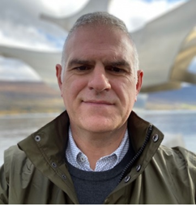
Ian Setchfield
Ian is an Acute Care Nurse Consultant, currently working for East Kent University Hospitals Foundation NHS Trust (EKHUFT). Prior to this he worked as a Critical Care Matron and before joining the NHS in 2005 served for 13 years as member of the Critical Care Air Support Team in the Royal Air Force.
He is passionate about effective clinical leadership and cultural change, ensuring a ‘whole system approach’ is utilised to patient pathways. Clinically he is an expert practitioner in the deteriorating patient and acute medicine. Ian is also the Advanced Clinical Practice (ACP) lead at EKHUFT, works as a visiting senior lecturer in ACP at Canterbury Christ Church University and is an International Fellow of The England Centre of Practice Development. Ian was also a founding triumvirate of Kent's ACP Forum.
Ian is an accomplished national speaker and is currently working with Health Education England’s Centre for Advancing Practice. Nationally he has been the nurse representative for The Society for Acute Medicine, deputy Chair for the RCN Professional Nursing Committee and has contributed to several national standards including NICE. Ian is also a Member of Health Education Kent Surrey Sussex ACP steering group and Leadership Academy Reference group.

Slide 52
Kent and Medway ACP Forum
@KentACP

Slide 53
Next Steps – Development Groups
In order to ensure the continued development and support of those working at / or towards an Advancing Clinical Level the East Kent Training Hub is supporting the development Advanced Clinical Practice Development Groups.
Offer –
Advanced Clinical Practice Development Groups :–
1 Facilitated cohort -
2 Train the training cohorts
Aim –
Each Primary Care Network to have a minimum of 1 person trained to facilitate future Advanced Clinical Practice Development Groups across the locality

Slide 54
Facilitated Advanced Clinical Practice Development Groups
Facilitated Action Learning Sets
9 x 2 hour sessions 8-10 places
Advanced Clinical Practice Development Groups are for those working at an advanced level, starting the MSc ACP programme, extended role practitioners looking to become ACPs, Leaders in their field of practice.
Post facilitated sessions it is encourage that peer support groups are ongoing and self-sufficient and will continue beyond the Advanced Clinical Practice Development Groups.

Slide 55
Train the Trainer Sessions
6 x 2hour sessions - 2 cohorts 8-10 places per cohort
These train the trainer session are for those working with individuals working at an advanced practice level, either supporting/training or managing such staff, with a view of facilitating Advanced Clinical Practice Development Groups in the future.
You must have knowledge of the Multi professional Framework and be an advocate/champion/Lead for Advanced Clinical practitioners in your Primary Care Network.
Aims
To empower, support and train champions and ACP Leads to deliver Advanced Clinical Practice Development Groups across their Primary Care Networks
To gain an in depth understanding of the level of practice that the HEE Multi Professional Framework expects
To understand what is required for each pillar and provide tools to demonstrate this.
To explore the Advanced Clinical Practice Multi Professional Framework, and how it is designed in order to map staff to the Framework
To be able to identify needs and gaps staff have moving forwards.
To create, facilitate and encourage peer support Advanced Clinical Practice Development Groups that are ongoing and self-sufficient and will continue beyond the Advanced Clinical Practice Development Groups provided

Slide 56
Expectations
Anyone undertaking the MSc ACP programme on a commissioned place will be expected to attend Advanced Clinical Practice Development Groups in the future as part of the educational agreement.

Slide 57
Next Steps - Scoping
Scope AP provision within East Kent
Map current APs against the ACP framework four pillars
Identify gaps – educational/experiential
Understand & plan allocations of appropriate resource
Highlight any potential gaps
ACP Working Group ?

Slide 58
Questions ?

Slide 59
Contact
eastkent.traininghub@nhs.net

