Slide 1

Study @ Supper with East Kent Training Hub

Slide 2
Clinical Biochemistry
Dr Sally Stock
Consultant Clinical Scientist
Head of Service for Clinical Biochemistry and Immunology
EKHUFT
follow us on Twitter @EKHUFTPathology

Slide 3

Introduction to the service
Clinical Biochemistry has laboratories on the three acute Trust sites in East Kent
All primary care work is processed at the WHH
Our specialist immunology service is located at the WHH
The service is accredited by UKAS to ISO 15189 (laboratory reference 8636).
We process more than 9 million individual biochemistry and immunology tests each year. Analyses are performed using the latest technology by qualified, HCPC registered scientific staff assisted by trained support staff.

Slide 4
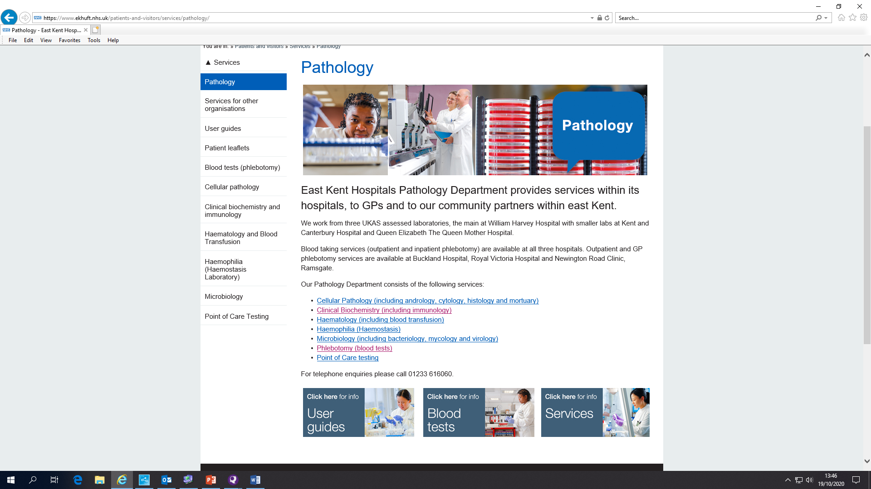
Location of useful guidelines and information for users
https://www.ekhuft.nhs.uk/patients-and-visitors/services/pathology/

Slide 5
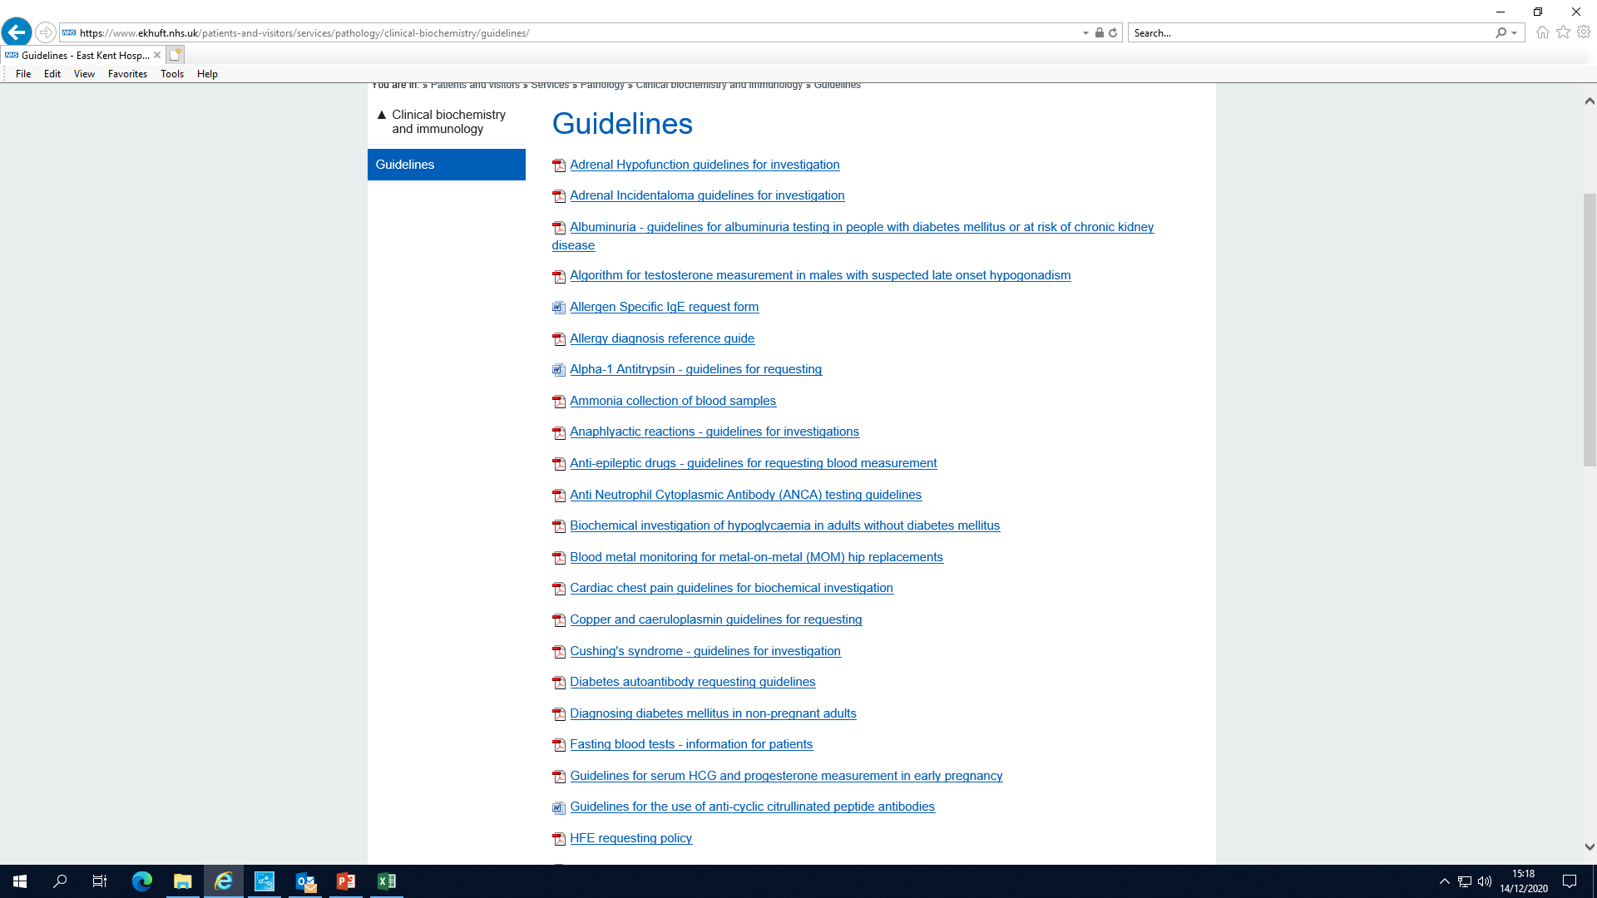
Location of useful guidelines and information for users
https://www.ekhuft.nhs.uk/patients-and-visitors/services/pathology/

Slide 6

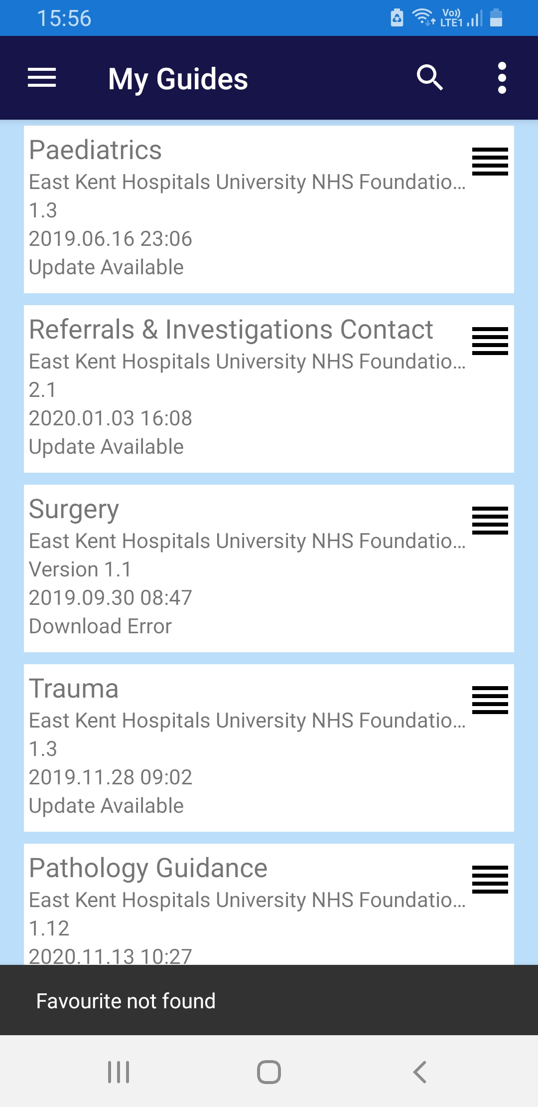
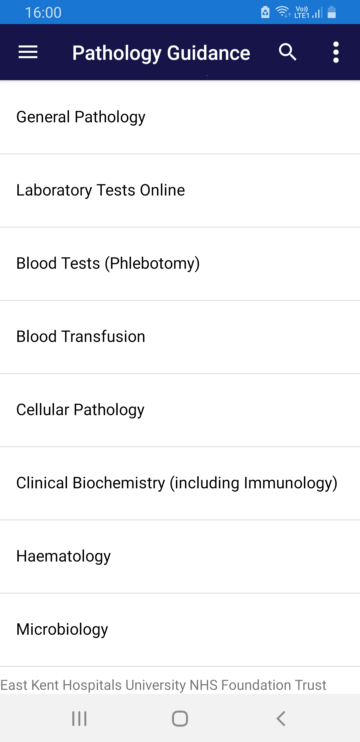
MicroGuide – pathology app

Slide 7
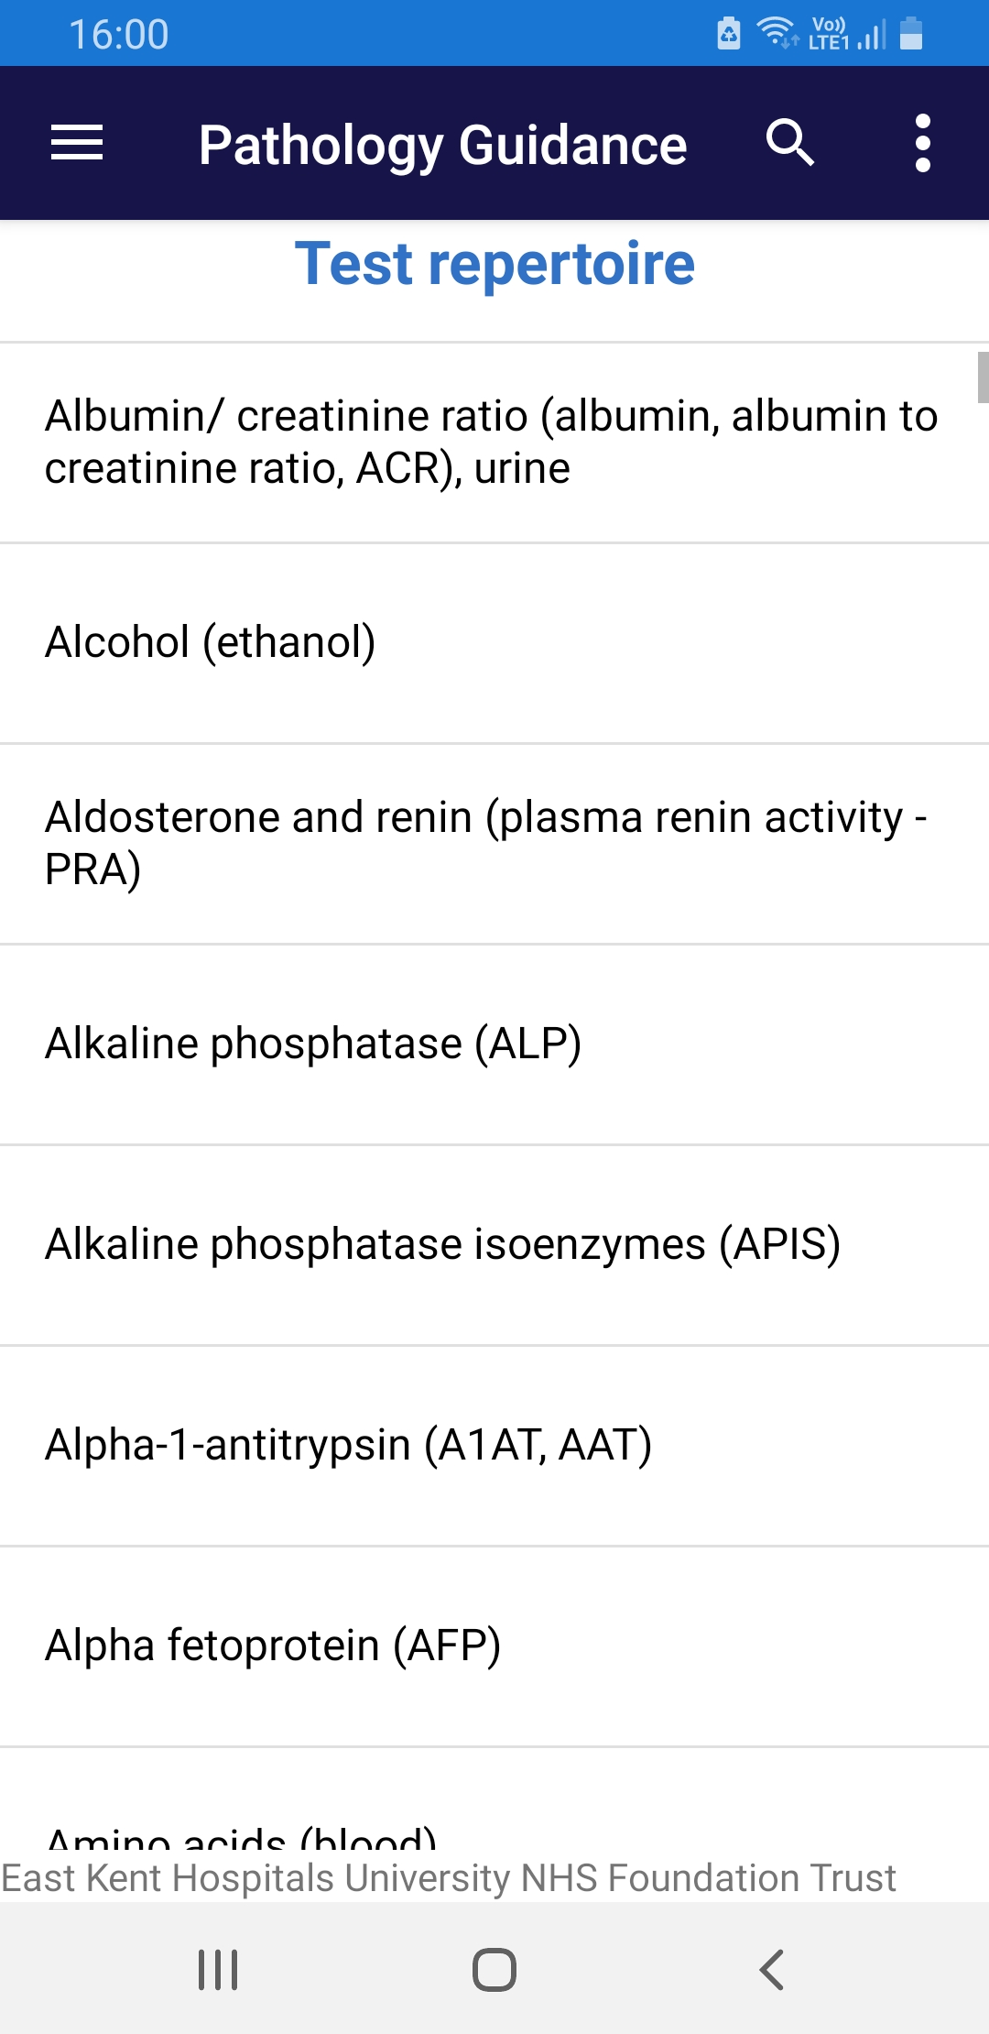
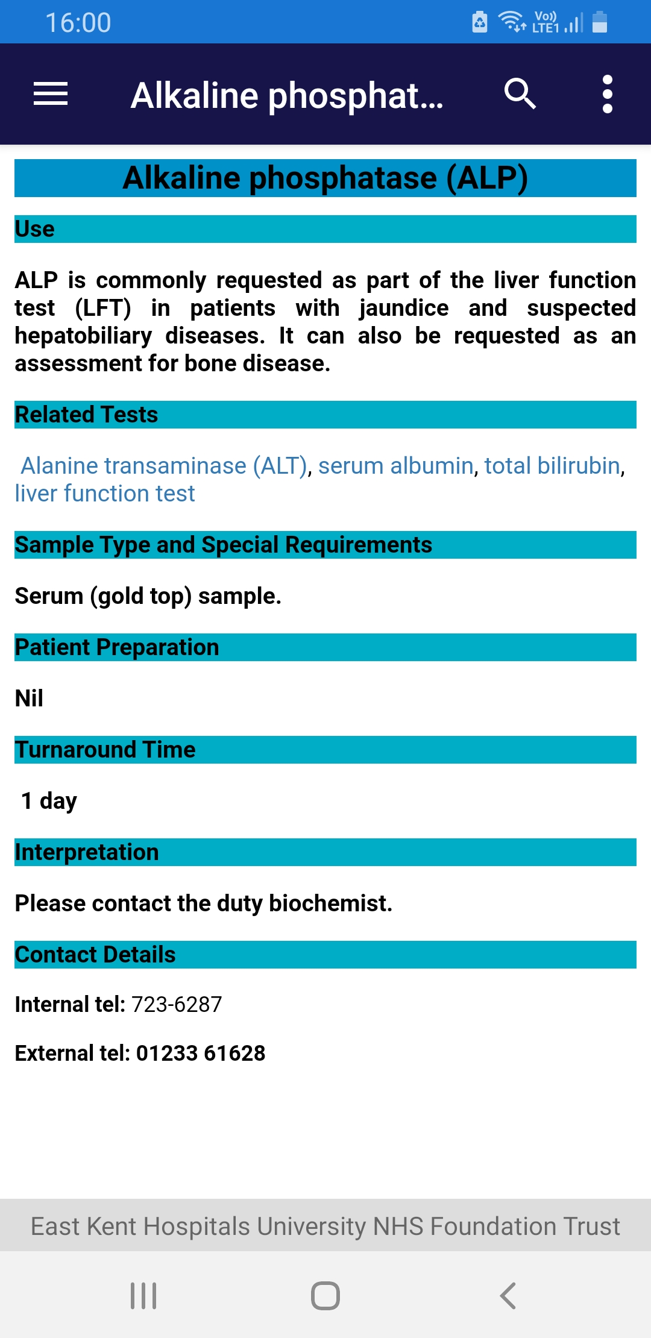
MicroGuide – pathology app

Slide 8
Introduction of TSH (thyroxine monitoring)
NICE Guideline [NG145] “Thyroid disease: assessment and management” recommends TSH alone should be used to monitor patients with primary hypothyroidism treated with T4
TSH only request introduced in May 2020 for monitoring such patients ONLY : TSH (Thyroxine monitoring)
As per NICE guidance:
Suggest assess TSH at 3 month intervals until level stabilised
Once stable, monitor annually

Slide 9
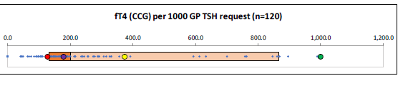
GETTING IT RIGHT FIRST TIME

Slide 10
How to request ‘TSH only’
Test name: TSH (thyroxine monitoring)
“On thyroxine (annually)” test group on DART
Only available in adults
Cannot request at same time as TFT

Slide 11
TSH (thyroxine monitoring)
Interpretive comments provided based on TSH result
All comments assume patient on thyroxine
Important that test is therefore only used for patients treated with thyroxine for primary hypothyroidism

Slide 12
Thyroid function test profile
The TFT profile (FT4 and TSH) remains available and should be used to assess thyroid function in patients:
i) not known to have thyroid disease
ii) with thyroid disease where the diagnosis is NOT primary hypothyroidism
iii) in patients on T4 with normalised TSH but continued symptoms
iv) Patients treated with T4 for pituitary disease or thyroid cancer
v) Anyone under 18 yrs old

Slide 13
Introduction of plasma metanephrines (pMETs)
Indication for screening phaeochromocytomas and paragangliomas (PPGLs)
Classic triad of symptoms: palpitations, headaches, diaphoresis (sweating).
Hypertension, in particular paroxysmal hypertension (30%) or orthostatic hypotension
Adrenal incidentaloma ≥1 cm with clinical features that suggest PPGLs
Asymptomatic patients with an inherited disorder associated with an increased risk of PPGLs such as multiple endocrine neoplasia (MEN) 2A and 2B, Von Hippel-Lindau disease, and neurofibromatosis type 1.
Note: Urinary homovanillic acid (HVA) is the recommended test to screen for neuroblastoma in paediatric patients.

Slide 14
Introduction of plasma metanephrines
Previous practice - 24h urine collection for catecholamines
Diagnostic accuracy significantly improved
New testing service – A single blood sample for pMETs
How to request in DART
Please search under the test name: plasma metanephrines
Sample requirements
Fasting sample
Samples cannot be collected in primary care
Patients must attend phlebotomy outpatients at one of the three acute hospital sites (i.e. at K&CH, QEQMH or WHH) for sample collection. Patients must be seated for a minimum of 10 minutes prior to sample collection.

Slide 15
Introduction of plasma metanephrines
Interpretation of results
Results within reference range
Results do not suggest the presence of phaeochromocytoma or paraganglioma
Results above reference range
Depending on the level of elevation
Exclude interfering dietary factors such as caffeinated foods and drinks, catecholamine rich foods (e.g. bananas, plums, pineapples, walnuts, tomatoes, avocados, aubergines, alcoholic drinks, vinegar)
Exclude interfering drugs e.g. antidepressants and antihypertensives (especially beta-blockers and non-selective alpha-adrenoceptor blockers).
Refer to Endocrinology for discussion and follow up investigations. This may include measurement of plasma metanephrines in a supine position. This can only be requested by secondary care.

Slide 16
GP – Myeloma Diagnostic Tool
Dr Joanna Sheldon
Visiting Consultant Immunologist
Immunology EKHT
https://academy.myeloma.org.uk/resources/gp-myeloma-diagnostic-tool/
https://www.myeloma.org.uk/videos/digital-infoday-session-myeloma-from-diagnosis-to-treatment/

Slide 17
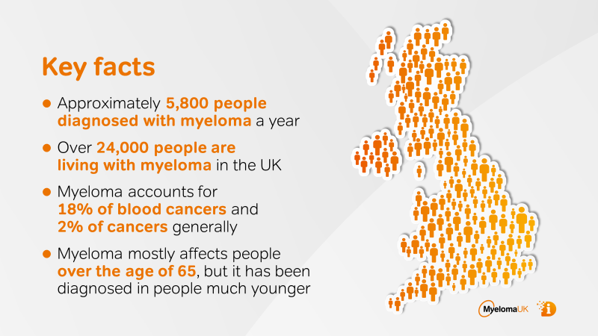
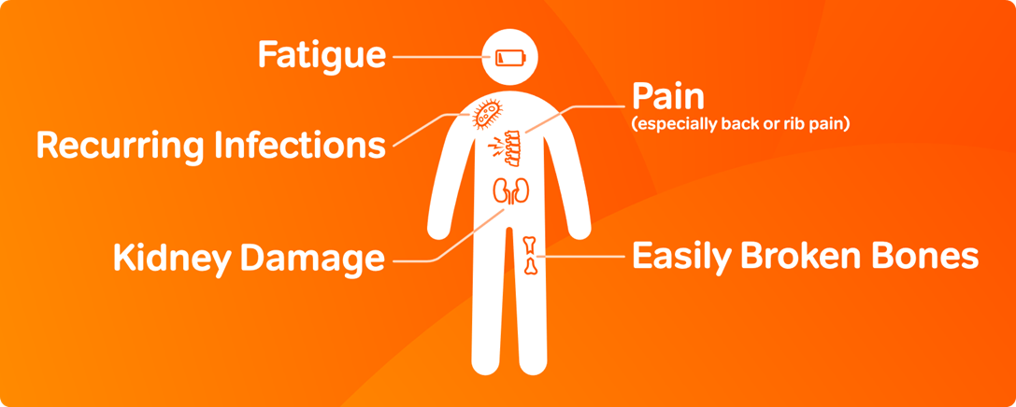
Myeloma
How if affects the body

Slide 18
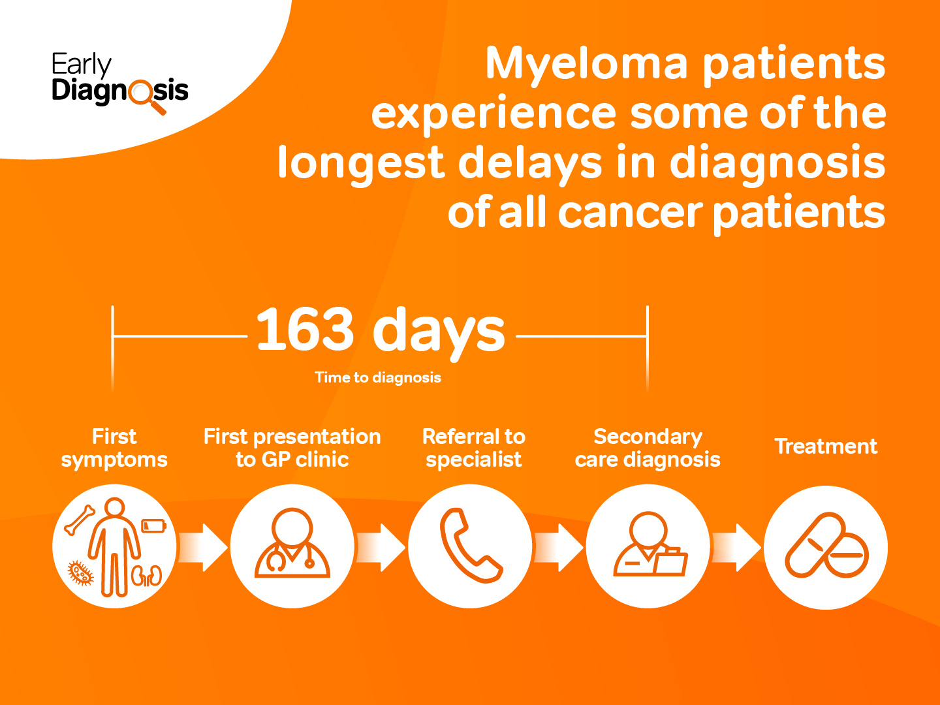
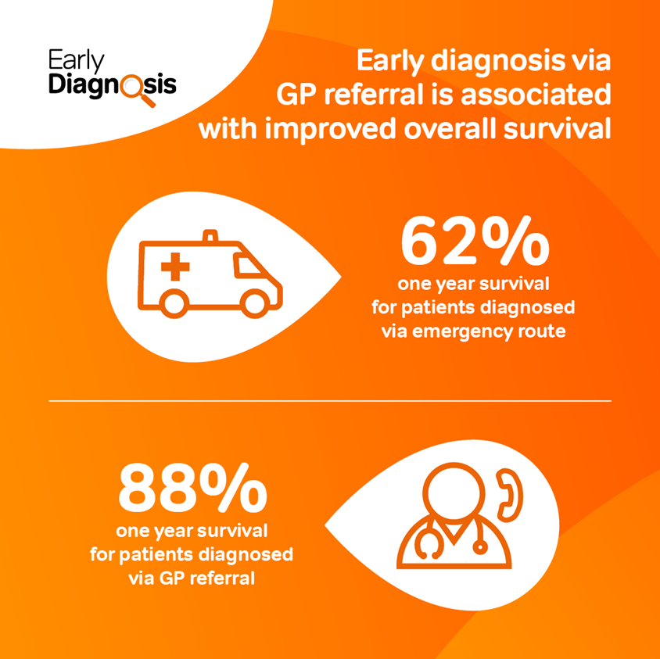
Why have we developed the
GP – myeloma diagnostic tool?

Slide 22
GP – Myeloma Diagnostic
Tool
Written by Haematologists, Immunologists and Myeloma UK
To give GPs a simple tool to help:
  identify patients where testing for myeloma is indicated
  guide test requesting
  guide on the interpretation of results
  determine appropriate next steps
Reduce the diagnostic time patients with myeloma
More information is available at:
https://academy.myeloma.org.uk/resources/gp-myeloma-diagnostic-tool/
https://www.myeloma.org.uk/videos/digital-infoday-session-myeloma-from-diagnosis-to-treatment/

Slide 23
16th December 2020
East and North Kent Training Hub
COVID-19 Testing, Isolation and Tracing
Dr Samuel Moses
Consultant in Virology and Infection, Honorary Senior Lecturer, University of Kent East Kent Hospitals University NHS Foundation Trust

Slide 24
Declaration
All views are my own; they do not represent the views of either of my affiliated organisations

Slide 25
SARS CoV 2 Virology
Coronaviridae
The subfamily Orthocoronavirinae of the family Coronaviridae is further classified into four coronavirus (CoV) genera: Alpha-, Beta-, Delta- and Gammacoronavirus.
Alphacoronavirus: NL63, 229E
Betacoronavirus genus is further separated in five subgenera (Embecovirus, Hibecovirus, Merbecovirus, Nobecovirus and Sarbecovirus)
  Sub-genus Embecovirus (previous lineage A)
    species includes HKU1, betacoronavirus 1 that has sub-species OC43
  Sub-genus Sarbecovirus (previous lineage B)
    species includes SARS-1, SARS-2
  Sub-genus Merbecovirus (previous lineage C)
    species includes MERS
  Sub-genus Nobecovirus (previous lineage D)
  Sub-genus Hibecovirus (additional 5th genera)

Slide 26
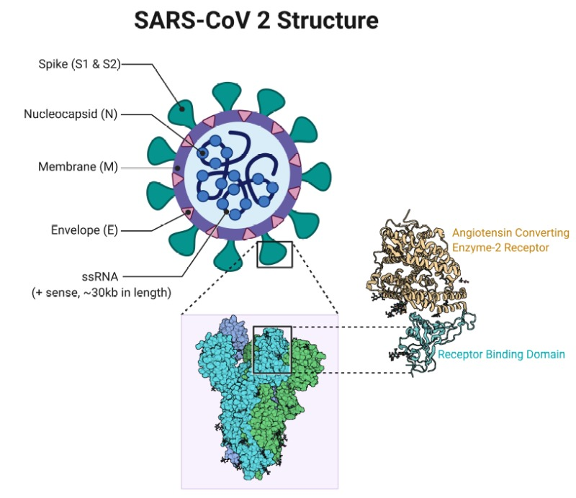
SARS CoV 2 structure
single stranded positive sense RNA virus
Outer envelope:
  Spike protein
    Trimeric protein with receptor binding domain (RBD); S1 contains RBD for ACE-2
    S1/S2 cleavage by host furin protease
    S1: virus attachment; S2: membrane fusion
  Envelope protein
  Membrane protein
Inner core:
  Nucleocapsid (nucleoprotein)
  25 other non-structural / accessory proteins
  ssRNA genome

Slide 27
Virus Detection
Usual methods:
  Particle / component detection
    Nucleic acid (RNA)
      Current widely used: PCR, LAMP, TMA; all of which test for presence of RNA
    Antigen
      Still in development, not yet widely used in clinical or public health environments
  Culture
    CL3 facilities needed
    Less sensitive than RNA or possibly even antigen

Slide 28
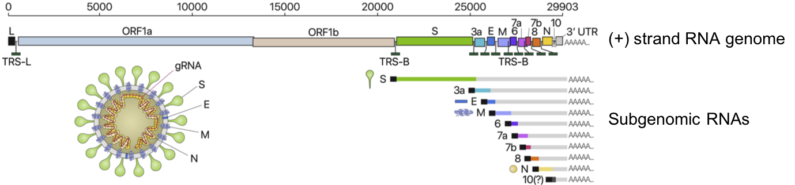
What is the RNA that we look for?
Figure 1: Genome organisation of SARS-CoV-2 (adapted from¹). Upon viral entry into the cell, non-structural proteins are translated directly from the (+) strand RNA genome, while subgenomic transcripts (which encode structural viral proteins required for onward transmission) are generated by transcription from (-) strand RNAs produced during viral replication.
1) Kim, D. et al ‘The Architecture of SARS-CoV-2 Transcriptome’ Cell 181(4):914-921 (2020)

Slide 29
Antigen vs RNA detection
Body compartment | Antigen (best of either nucleocapsid or spike components | RNA (best of various gene targets: N, E, orf1ab, RdRp, M)
Nasopharyngeal | Clinical sensitivity ≈ 80% Specificity ≈ >95% | Clinical sensitivity ≈ 90% Specificity ≈ >95%
Oral/saliva | Clinical sensitivity ≈ 90% Specificity ≈ >95% | Clinical sensitivity ≈ 90% Specificity ≈ >95%
Sputum / lower respiratory | Not suitable | Clinical sensitivity ≈ 95% Specificity ≈ >95%
Serum/Blood | Not relevant | Not relevant; viraemia transient; no correlation need with severity as severe disease is immune mediated

Slide 30
Current Steps: RNA Testing
Symptomatic testing: NHSE/RCPath Guidance
  Swab (nose & throat) up to Day 5 of symptoms
    Positive → Isolate as per PHE/NHSE guidance
    Negative → repeat test if needed
    → other viruses or infection targets as per clinical condition
  Evolving knowledge
    How long is a person infective if shedding RNA for a long time
      Infectivity period: 10 days in community; 14 days in hospitalised (higher risk)
      Until 90 days detected RNA is considered as part of previous episode (remnant, non-infectious)
    How much is missed if we do not cover for asymptomatic transmission
      20 – 30% still potentially asymptomatic; ≈ 10% pre-symptomatic transmission

Slide 31
What about asymptomatic RNA testing
NHSE asymptomatic RNA testing pilots:
  11 Acute NHS Trusts pilot in April Care Home pilots
Asymptomatic pilot data:
  34/36 positives in 1 centre were in non-COVID ward area
    Potential impact from reduced control measures such as social distancing/hand hygiene
    25% of them developed symptoms 4 days later, and another 25%; 7 days later

Slide 32
Potential Next Steps: RNA Testing
Expanding RNA testing to asymptomatic
  Potential tiered approach
    exposure category risk stratified
      By healthcare environment i.e. acute admission, ITU etc.
    ?focus on pre-status IgG negative individuals, vulnerable individuals
    ?no need or reduced need in IgG positive, immunocompetent individuals
    What about reinfections and recrudescences?
      Current 90 day moratorium
  What is the frequency of testing?
    Inpatients: Currently it is day of admission, day 3, day 5-7
    Healthcare workers: twice a week Lateral Flow Device antigen testing

Slide 33
Immune response detection
Cell mediated (T-cell) immunity response
Humoral antibody response
  Serum compartment
  Mucosal (saliva/oral)

Slide 34
Current Steps: Antibody testing
IgG assays rolled out to all NHS Trusts
IgG assays targeting Nucleocapsid, Spike proteins
Currently for testing all patients on admission and staff catch up with consent
Information gathering tool as of now

Slide 35
Antibody responses
3 classes of antibodies:
  IgM (acute phase reactant: by day 7)
  IgG (later evolving as mark of exposure: by day 14)
  IgA (secretory Ig: more correlated with severity of illness)
Antigens targeted:
  Nucleocapsid (nucleoprotein)
  Spike
    Combination of S1, S2, specific RBD protein sequences

Slide 36
To be understood: Antibody Testing
Current NHSE rollout IgG assay performance:
  Adequate sensitivity, specificity parameters in initial evaluation
Need to understand the clinical and epidemiological relevance of IgG
  Is it neutralising antibody?
    Is Spike protein antibody more relevant than nucleocapsid?
    Or do we need evidence of both?
    Or is there another antibody target to be looked at?
  Does it offer protection against infection?
    Is evidence of estimated protection from severe disease alone adequate?
    How long does the protection last?
      REACT Trial: 120 days

Slide 37
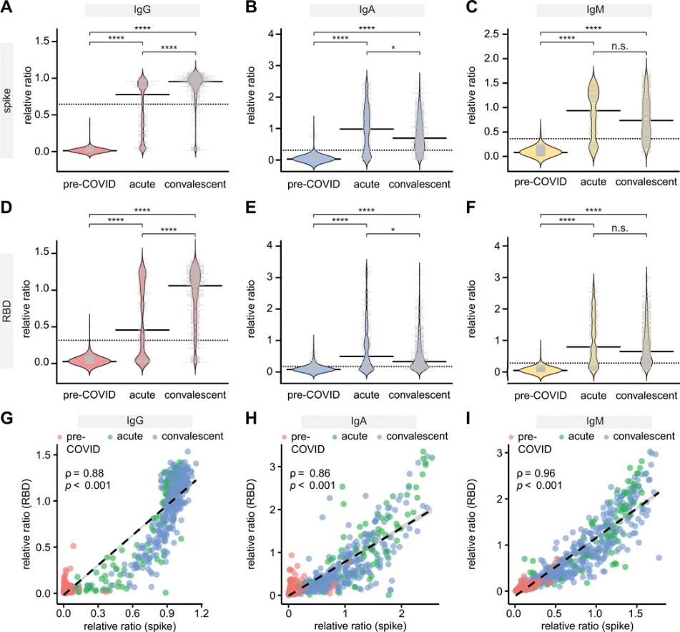

Serum: Cross-sectional analysis of IgG , IgA responses to the spike, RBD antigens
Acute <21 days; convalescent >21 days post symptom onset (PSO)
Baweleta Isho et al. Sci. Immunol. 2020;5:eabe5511
Copyright © 2020, American Association for the Advancement of Science
Notes:
Cross-sectional analysis of IgG and IgA responses to the spike and RBD antigens of SARS-CoV2 in serum. (A-F) Indicated immunoglobulins to spike and RBD were profiled by ELISA in cohorts of pre-COVID samples (n=300), hospitalized patients with acute COVID infection (n=132) and convalescent patients (n=364). All data, expressed as ratio-converted ELISA reads to a pool of convalescent samples (relative ratio), were plotted using bean plots. Solid bars denote the median and dotted line represents the median across all samples used in the plot. (G-I) levels of IgG (G), IgA (H) and IgM (I) to the RBD (y-axis) and spike (x-axis) antigens for the indicated patient groups. Spearman correlation coefficient is indicated. Mann-Whitney U test for significance was performed. n.s = not significant, *= p ≤ 0.05, **** = p < 0.0001.

Slide 38
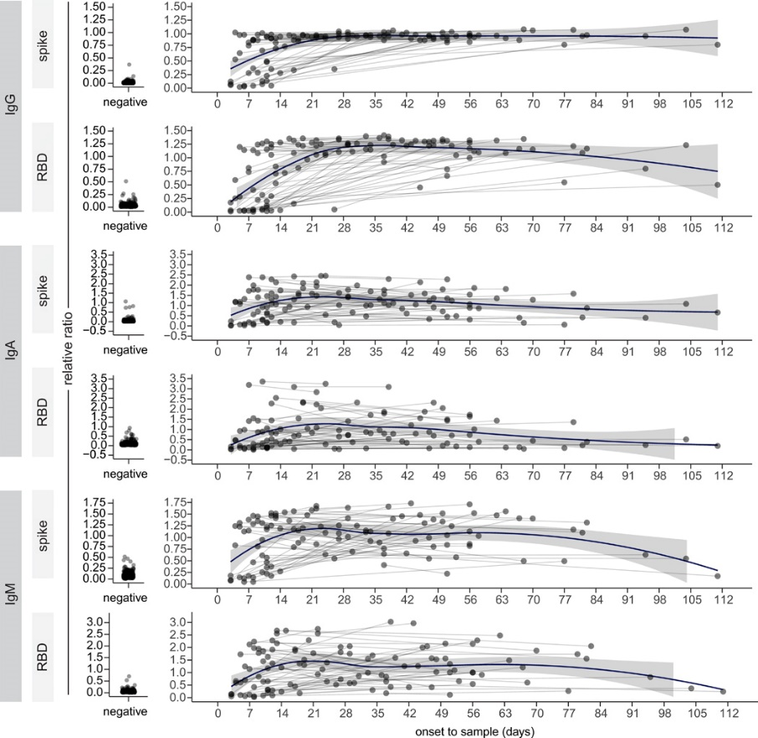
Serum: A longitudinal analysis of IgG and IgA responses to the spike, RBD antigens
Baweleta Isho et al. Sci. Immunol. 2020;5:eabe5511
Copyright © 2020, American Association for the Advancement of Science
Notes:
A longitudinal analysis of IgG and IgA responses to the spike and RBD antigens of SARS-CoV2 in serum. Analysis of the changes in the indicated Ig-antigen levels in patients profiled twice, in comparisons to the relative levels in pre-COVID negative controls (left). Dots represent individual serum samples collected at the indicated times, and the samples from the same patients are connected by the lines. A non-parametric loess function is shown as the blue line, with the grey shade representing the 95% confidence interval.

Slide 39
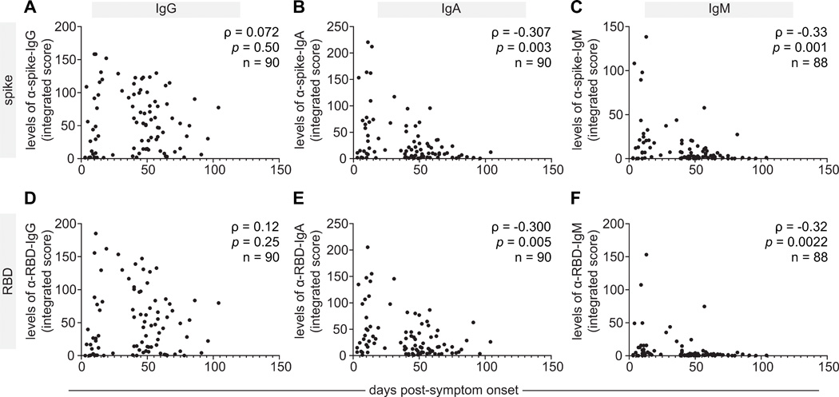
Saliva: cross-sectional analysis of antibody responses to the spike, RBD antigens
Baweleta Isho et al. Sci. Immunol. 2020;5:eabe5511
Copyright © 2020, American Association for the Advancement of Science
Notes:
A cross-sectional analysis of antibody responses to the spike and RBD antigens of SARS-CoV-2 in saliva correlated with time PSO. A second cohort of COVID-19 patients (n=90) was tested for the presence of IgG and IgA antibodies to SARS-CoV-2 spike and RBD antigens in the saliva, comparing with a mixture of unexposed negative controls collected locally and pre-COVID era negative controls. (A-F) Saliva data for all 6 antigen-specific ELISA readouts plotted as time PSO. Spearman correlation coefficients (ρ) and p-value are indicated. In multivariable analysis adjusted for age, sex and severity of illness, there was a significant decline in anti-RBD and anti-spike IgA, but not significant change in the level of anti-RBD or anti-spike IgG.

Slide 40
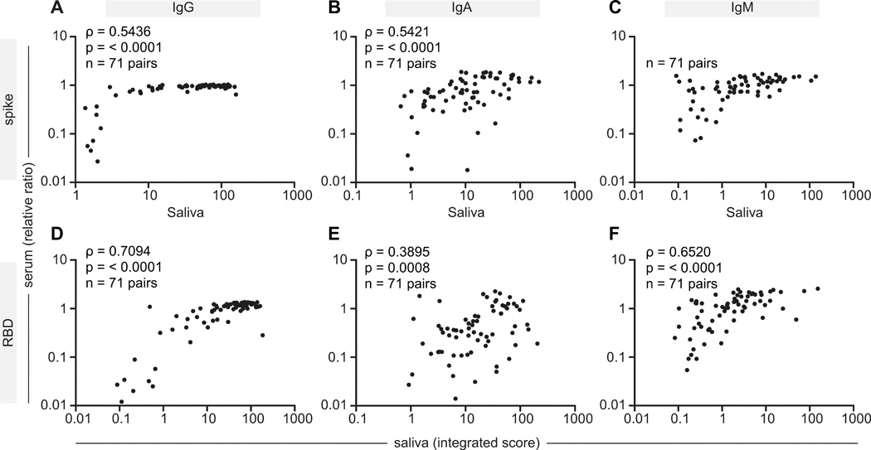
Correlation of IgG, IgA and IgM responses to the spike and RBD antigens in serum and saliva.
Correlation between serum and saliva stronger for IgG, IgM >IgA for spike as well as RBD
Baweleta Isho et al. Sci. Immunol. 2020;5:eabe5511
Copyright © 2020, American Association for the Advancement of Science
Notes:
Correlation of IgG, IgA and IgM responses to the spike and RBD antigens in serum and saliva. (A-F) A subset of serum and saliva sample pairs (n=71) collected from the same patient within 4 days were analyzed for correlations in levels of anti-spike and anti-RBD IgG, IgA and IgM antibodies. For serum, data are presented as ratio-normalized ELISA reads, while the saliva results are expressed as an integrated score, as in previous figures. The data are presented on a logarithmic scale. Spearman correlation coefficient (ρ) and p-value are indicated.

Slide 41
Potential Next Steps
Integrated RNA – IgG testing
  Need to understand longevity and functional protection:
    3 monthly repeat testing potentially
    Identify
      Repeat infections: RNA becoming positive again after the loss of initial IgG
      Recrudescence: RNA becoming positive again with no loss of initial IgG
      Persistence: RNA remaining positive for a long time regardless of any IgG response or not
  Is it only serum IgG antibody that is of interest
    Need to assess mucosal saliva antibody response (IgG, IgA)
    See whether mucosal immunity is adequate protection from severe infection even in the absence of serum IgG

Slide 42
Final landscape?
Approach for 1st episode of SARS CoV-2
  Diagnostic (combinatorial approach)
    RNA (nose & throat or sputum +/- saliva/oral fluid)
    Serology (target spike or RBD)
      IgM, IgA
        Detected could indicate recent SARS CoV 2 within last 7 days (IgM), 14 days (IgA)
      IgG
        Detected could either be past exposure up to 3 months for spike/RBD
        Detected in recent infection too with earliest likely from 10-14 days PSO
  Surveillance
    Saliva RNA, saliva antigen testing
    Saliva IgG for population seroprevalence

Slide 43
Final landscape?
Approach for second and repeat episodes >3 months from previous
  Primarily RNA testing
  Sequencing of repeat RNA positives
  Serology
    May not be that useful in frontline diagnostics
    Potential surveillance, research interest

Slide 44
Post SARS CoV 2 era of Infection & Immunity diagnostics
Need to combine pathogen detection and host response detection
Single or grouped sample source looking at both Infection & Immunity
Infection & Immunity linked at new/evolving Diagnostics

