Slide 1
2.00pm K&M CCG update (Navin Kumta)
2.05pm Training Hub update
2.20pm How to do an effective remote consultation
(Steven Laitner)
2.50pm Break 10 minutes
3.00pm Safeguarding
Introduction Lynne Wright (5mins)
Trauma Informed Care- a short overview
Domestic Abuse- How has it been for the victim during lockdown/living with coercion and control.
The challenge of assessing abuse by phone or video link
Looked After Children- Adolescent
Child Sexual Abuse in the Family- relevant in light of lockdown
The challenge and need to improve care.
5.00pm -Close
Please be advised that the Q&A will open after each topic

Slide 2
Community Education Facilitation The Why (Vision), How and What
Ruth Germaine, Systems Transformation Fellow
Claire Rickard, Operations and Business Continuity Manager
Sara-Jane Kray, PCWDL
Shariq Lanker and Darren Cocker, GP Tutors

Slide 3
Place-Based Learning; The Vision
To grow, develop and sustain an effective workforce
With the skills, knowledge and expertise to deliver effective, safe, compassionate, consistent holistic care
To improve patient pathways, outcomes and the wellbeing of the local population
Evolving with changing needs

Slide 4
Community Education Facilitation; The vision
Place-Based Learning to be embedded within PCNs as a core day to day activity
Allowing PCNs to develop a multiprofessional workforce that meets the needs of their local population and communities

Slide 6
How will the vision be achieved?
Development of CEF leads
in Place-Based Learning and workforce development in each PCN
That sit alongside PCN clinical directors
Working closely with all people and creating close links with the Training Hubs

Slide 7
How will the vision be achieved?
Service Level Agreement with the PCN and Training Hub for a Medical, Non-Medical and Admin Lead
Place-Based Learning across PCNs Implementation and Impact Framework
Community Education Competencies and Capabilities

Slide 8
What; CEF Administration
Coordination of placements, education and timetabling
Manage funding streams
Monitor and evaluate feedback and teaching to identify CPD requirements
Oversight of all activity and information

Slide 9
What; CEF System leaders for education training and support
Lead on and develop a shared vision for Place-Based Learning within the PCNs
Create an effective Place-Based Learning environment

Slide 10
What; Community Education Facilitation
Creating an effective Place-Based Learning Environment
Increasing placements
Supporting
new roles
Developing
lifelong learning

Slide 11
How will the vision be achieved?
Everybody being involved to develop all people

Slide 12
Remote Access, Triage and Consulting
Dr Steven Laitner
GP
Health Consultant
@SteveLaitner

Slide 13
A new paradigm
Remote consulting is different and challenges us in many ways:
Our purpose and identity (what is primary care for, what are WE here for?)
Our culture (how we think about and treat people and their needs)
Our systems (workflow….technology)
Our clinical interactions (how we consult)

Slide 14
Context (1 of 2)
We are the first port of call for healthcare (the clue is in the name!)
Urgent care, preventative care, screening, LTC management, relational care, holistic care, family care..
Without access we can’t help people (we haven’t always provided great access and we now now what happens if ppl don’t access care)
Demand for healthcare is large but it isn’t infinite
Demand is manageable (but making access difficult isn’t a good way!)

Slide 15
Context (2 of 2)
History….examination….investigation (traditionally 1 AND 2 then ?3)
80% of diagnosis is in the history alone
Much of human interaction is remote (even BC)
GPs are experts in managing undifferentiated demand and have excellent interpersonal skills
New roles in primary care and wider health and care system, a GP isn’t necessarily the answer to all life’s ills

Slide 16
Total primary care contacts have decreased. 66% of the remaining contacts were delivered remotely, however only 2% of these were video consultations
Average daily primary care contacts May – September 2019 vs. April 2020 in North East London CCGs (NEL CCGs) Average daily primary care contacts
Primary care contacts in NEL CCGs (May 2019 and April 2020) Primary care contacts by setting – in-person vs. remote
Remote primary care contacts – North East London CCGs (April 2020) Remote primary care contacts by setting – video vs. phone consultation
-31%
17% remote
66% remote
Source: Discovery; NEL CCG provided data; CF Analysis

Slide 17
Local Context in Kent and Medway
BC – 25% of practices offered virtual consultations
AC – 75% are now doing so
25,500 video links (March to May 2020)
28,000 online consultations (March to May 2020)
Many more GP advocates now
PCN level Primary Care Treatment Centres for Covid-19
Home working for staff
Wellbeing and ongoing needs support at home for patients (nhs.uk/health-at-home)

Slide 18
“talk before you walk”
Click – asynchronous (self help, digital support, send images, self monitoring)
Call – synchronous (phone, video)
Check in (face to face)

Slide 19
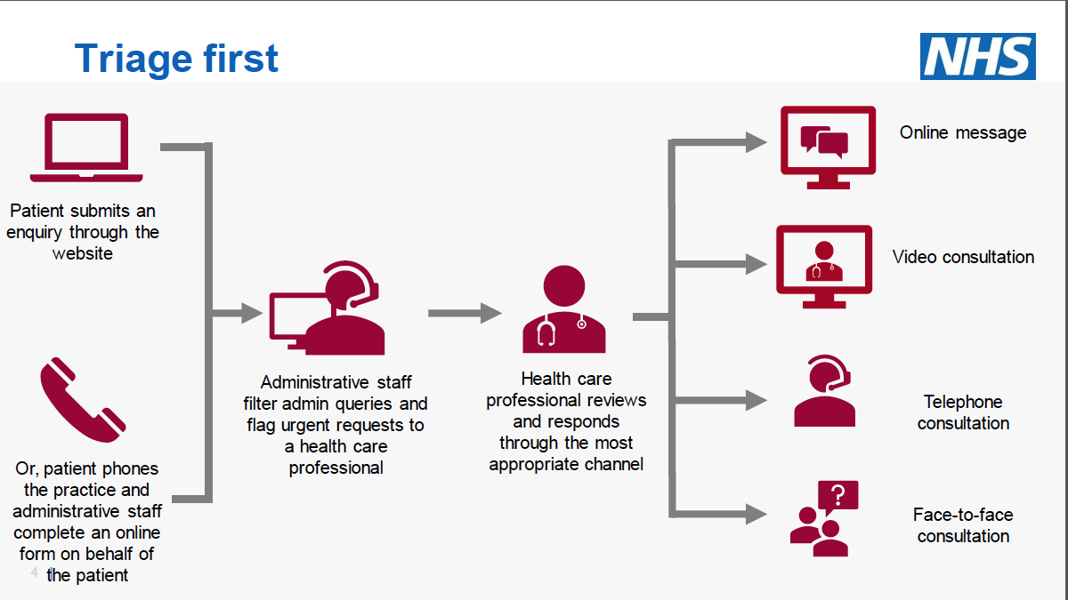

Slide 21
Foundry Teams
Acute Care |  | Generally well |  | Long term conditions |  | Complexity of LTC(s) and/or disability
 |  | Low risk | High risk | Low risk | High risk | Low risk | High risk
Children and Young People | Neonates Infants Toddlers Children Adolescents
Working Age Adults | Young Middle aged Older working age
Older People | 65-80 80-90 90+
Acute Team
Nurse Practitioner
Paramedic
GP
Continuous Care Team
GP
Pharmacist
Multi-Agency
Team
Specialist
Case
Management
Dementia

Slide 22
Single point of access (non-clinical triage)
Acute / Same day response (clinical triage)
LTC + Complex
(named care coordinator)
Prevention and Screening
Routine / LTC
Team 1
Team 2
Team 3
PCN wide
Practice level
Practice level
Notes:
Long term PCNs may aim for a single point of access (call centre) to provide non-clinical triage and signposting to the most appropriate team or other service.
Suggested teams might include:
Prevention / screening – clinic based offer which may be hub accessible by each of the practices
Acute / same day – this could be a clinic based offer with clinical triage to determine if advice can be given over the phone including; i) referral to another team (e.g. for a blood test) or ii) a face to face same day appointment is needed or iii) home visit is required or iv) to escalate (e.g. if an ambulance is required)
Routine / Support for patients with LTC (non-complex) – this may be practice level service
Complex support for patients with multiple LTC or complexity – this will be a MDT approach and is likely to include a named care coordinator and practice level support
Teams can be designed to deliver services may be across the PCN or at the practice level – the rurality of a PCN may determine this.

Slide 23
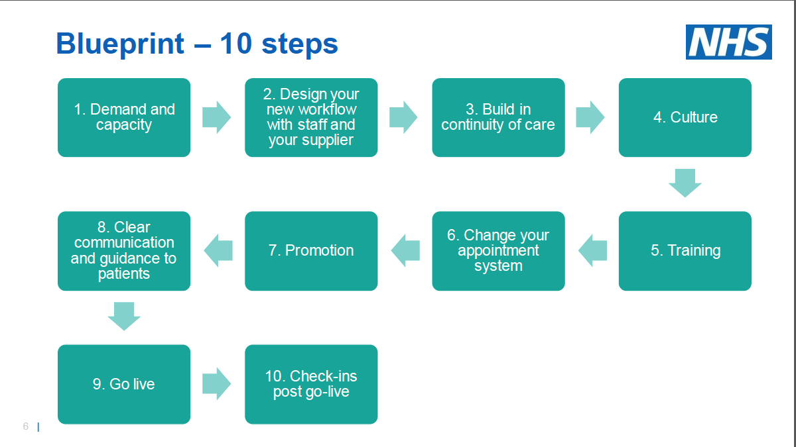

Slide 24
Tips – think about…..
Use a headset!
Before the call check age, gender, PHM, recent history and reason for the call today
Confirmation of who speaking to (Name, DOB, Address)
Third party - need to hide from notes?
Manner - cheerful, professional, empathy
Listen, golden 30 seconds + ….other issues?
Don’t be rushed, summarise their info and the agreed plan.
If need to see, STOP and arrange (when, where, who, how long, what prep?)
Needs AND preferences

Slide 25
Tips – think about…..
Photos?
Video?
Recent NHSE/I guidance on intimate examinations
Symptom text or diary?
Check if happy?
Text with summary of advice
Leaflets ++
Safety netting +++

Slide 26
Resources

Slide 27
Questions/ Comments/ Concerns?
steven.laitner@nhs.net
@SteveLaitner

Slide 28
Barriers
Can’t make a diagnosis without examination
Patients always want to see me
I want to see my patients
What about those non verbal clues
Can’t form a relationship by phone
I will get sued
I need my pill check or sore throat to catch up
Demand will rocket
Need to keep access challenging in order to manage demand
I need to develop a relationship with people through seeing them with their sore throat etc

Slide 29
East Kent Safeguarding Training
July 2020

Slide 30
Topics
Trauma Informed Care: Sheridan Morrison
Domestic Abuse and Lockdown: Lisa Lane /Musthafar Oladosu
Looked After Children: Nancy Sayer/Roxanne Hills
Child Sexual Abuse: Katy Cawkwell
LeDeR, lessons to learn: Lynne Wright

Slide 31
Safeguarding during Covid and Trauma informed approach
Sheridan Morrison: Designated Nurse for Safeguarding Children
NHS Kent and Medway Clinical Commissioning Group
Notes:
Introduce self and reminder, will be recorded and sent around. Questions in the chatbox, will pick up some questions today but due to time, most questions will be picked up and response sent afterwards.

Slide 32
Overview of Session
Consideration of Safeguarding impact of Covid 19 /Lockdown on services and children and families
Very Brief overview of Adverse Childhood experiences and impact of Trauma
To consider how Primary Care can respond to the challenges of safeguarding
Links to further resources and training
Notes:
Just a reminder that can only comment through Q and A. No PID. Will take questions at the end of each presentation and if any don’t have time for, will include these and provide a response after to go out to everyone.

Slide 33
Impact of Covid 19 on Professionals
Important to recognise this has been a hugely challenging time for everyone.
As Primary Care Professionals, changes to way working and dealing with distressing things/ Own fears
Also as individuals, may have particular circumstances and may be affected e.g. home schooling, isolation, caring responsibilities for older parents, other worries.
Important to take time for self care and acknowledge the huge pressures we’ve been facing.
Do you have support mechanisms in place or do you need to find ways to get that?

Slide 34
Impact of Covid 19 on Services
Many services either on hold, reduced or delivered face to face / Children not in school
Primary Care - E consult and remote consults
Health Visiting /Midwifery/ Specialist services - Reduction or on hold / remotely
Overall significantly reduced face to face contact means that children and vulnerable adults may be more hidden and abuse less likely to be identified.
Notes:
Overall, significantly reduced face to face contact with families which may lead to children and vulnerable adults being more hidden and abuse or neglect not being identified.

Slide 35
What do you think the potential Safeguarding implications of Lockdown and Covid 19 are for both children and vulnerable adults? Can you write your thoughts and comments in the Q and A?

Slide 36
Link
Nadine Burke –Harris ( 6.55 – 9.31 )
https://www.youtube.com/watch?v=95ovIJ3dsNk

Slide 37
Issues during lockdown
Vulnerable adults and children will be less visible to services and abuse may be more hidden
Increased stress and issues may exacerbate existing issues including Domestic abuse/ mental health/ substance misuse / impact on parenting capacity
YP Mental health / Suicide / Self – Harm / CSA
Exploitation of adolescents, CSE, Gangs, missing episodes, online exploitation and grooming
Looked After Children and Care Leavers
Young Carers
Vulnerable people may be at more risk from those who may wish to exploit e.g. risk of scams
There might be an assumption that services are not there or people might feel reluctant to ask for help for fear of being a burden
Notes:
This list is not exhaustive but a range of the issues that may make some people more vulnerable

Slide 38
Adverse Childhood experiences
Adverse Childhood Experiences ( ACE’s ) are stressful or traumatic events that children can be exposed to and that change how they respond to stress. This can impact on chronic disease and mental health
Include Physical abuse, sexual abuse, psychological abuse, neglect, witnessing Domestic abuse or having close family members who misused drugs or alcohol or had mental health issues, or who spent time in prison, parental separation and divorce
Having 4 or more ACE’s significantly impacts on future health and increased risk of ill health
Notes:
Never more relevant than currently

Slide 39
Links
ACE Video
https://www.youtube.com/watch?v=XHgLYI9KZ-A

Slide 40
Framework for Assessment
Child’s Needs
Parenting capacity to meet child’s needs
Child
Environmental and Family Support
Notes:
A tool used to assess children. Framewor for Assessment. Child’s needs include love, education, stability, development needs, food, shelter - Varies depending on age of child and individual health and other issues
Parental capacity to meet those needs e.g. may be impacted by mental health, substance misuse, domestic abuse or other issues - May vary depending on needs and age of child and other factors. Parents physical needs e.g. Disabilities / Bereavement
Environmental and family support - Less social support, not seeing families, some community resources, housing, unemployment etc.

Slide 41
Vulnerability of Babies
New parents may have less support to cope with new babies e.g. crying which may place more at risk
If not seeing, may miss indicators of abuse e.g bruising or parent/ child interaction
Making contacts count e.g. 6 week check or immunisations - Ask how coping and provide links and support, remind of Health Visitor
ICON/ Crying babies and awareness of shaking risks
https://iconcope.org/
New Policy on bruising and leaflets for parents
Consider whether should see face to face weighing up risks
Notes:
Cases locally and nationally - Abusive Head Trauma

Slide 42
Trauma Informed Approach
Never more relevant than today
Currently families may be adapting and coping in response to crisis situation but the impact and stress may start to be more apparent post covid. Will have an impact on primary care capacity so worth being prepared for this
Trauma informed and resilience building practices can make a huge difference
The CCG have commissioned training on Trauma informed Care - Information to go out

Slide 43
Think Family
Neither adults or children exist in isolation and Think Family aims to promote the importance of a whole-family approach. Look at the whole family – If your role is working with adults or children, consider the family circumstances
Parental issues can adversely affect parenting capacity
If seeing parents, consider if a child in the family and impact and vice versa
Think Child, Think Parent, Think Family

Slide 44
Suggestions to consider
As a practice, are you aware of children or vulnerable adults who are more at risk?
Do you have regular MDT / Practice meetings/ Links with HVs
Do you have a “ Was Not Brought” policy?
Consider if new parents, babies should be seen face to face
Make every contact count - - Think Family
Do you have support information and resources to give to parents? For example DA or ICON coping with crying
Consider limitations of remote consults e.g. DA / perpetrators – How you can do these more effectively, share practice
Have you downloaded the NHS Safeguarding App?
Have you seen the 7 minute briefing and Safeguarding bulletins?
Notes:
No clearcut answers but asking to go away and consider issues and come back with suggestions. Highlighting challenges and complexity of primary care and working with safeguarding issues. Many issues only apparent with hindsight and recognise that may only have limited information. Cannot prevent or see all safeguarding issues but by being more aware, may pick up indicator and make a difference. If unsure, seek consultation or support from safeguarding team. Can’t refer for you but can talk through and help thinking and can support to escalate.

Slide 45
Thank you Questions or Comments

Slide 46
Additional Resources
Early Intervention Foundation Report on ACEs
file://resource/ccg/SKC%20Users/sheridan.morrison/Internet%20Explorer/Downloads/adverse-childhood-experiences-report.pdf
Was not Brought Videos https://www.youtube.com/watch?v=dAdNL6d4lpk
https://www.youtube.com/watch?v=jK7YaXoC5dc
Child Sexual Exploitation video training link https://www.youtube.com/watch?v=sC4Nn_mYKu0
https://www.kscmp.org.uk/guidance/sexual-abuse-and-exploitation
NHSE/I - National Futures Platform - Can join and link nationally on safeguarding
National Safeguarding App - Download NHS Safeguarding App on phone

Slide 47
Further Training Links
E learning training at Levels 1, 2 and 3, please see the link below. This is free to NHS staff and you can log in or register using the links at the top right of the page. http://www.e-lfh.org.uk
Kent Safeguarding Children multi-agency partnership training courses ( includes multi-agency training and e-learning on a range of topics ) https://www.kscmp.org.uk/training/find-training-courses
Kent and Medway Safeguarding Adult Board
Training links https://www.kent.gov.uk/social-care-and-health/information-for-professionals/training-and-development
All age Safeguarding training resources https://www.scie.org.uk/training

Slide 48
Responding to Domestic abuse during telephone and video consultations
NHS Kent and Medway Clinical Commissioning Group
Notes:
COVID 19 has affected peoples lives considerably, Domestic abuse numbers have surged since the start of lock down
Staff are working remotely, this session aims to address how to have difficult conversations regarding domestic abuse over the phone
We know that COVID-19 will have a detrimental impact on the safety and lives of patients affected by domestic
violence and abuse (DVA) and their children. Home may not be a safe place for those affected by DVA. Weeks or
months of self-isolation may be a dangerous and deeply difficult time for many, as their routes to support and
safety will be shut down or limited. GPs and other general practice clinicians play a vital role in addressing DVA in
the current COVID-19 pandemic and national lockdown. Usual routes of enquiring about and supporting patients
experiencing domestic abuse are no longer an option. Phone and video consultations are currently being used by
most practices in the UK in place of face-to-face consultations. This guidance aims to inform safe telephone and
video consultations with patients who are known to be at risk of DVA, when you suspect DVA and in response to
self-disclosures of DVA. As patients will speak with reception or triage staff before they speak to a clinician, it is
important that all staff in telephone or video contact with patients have an understanding of the effect of domestic
abuse on their patient population and the current risks during the COVID-19 pandemic. Clinicians should check
whether a patient’s medical record includes a Safeguarding/DVA code before conducting a telephone or video
consultation.

Slide 49
Definition of Domestic Abuse
Any incident or pattern of incidents of controlling, coercive or threatening behaviour, violence or abuse between those aged 16 or over who are or have been intimate partners or family members regardless of gender or sexuality. This can encompass but is not limited to the following types of abuse:
psychological
physical
sexual
financial
Emotional
Controlling behaviour is: a range of acts designed to make a person subordinate and/or dependent by isolating them from sources of support, exploiting their resources and capacities for personal gain, depriving them of the means needed for independence, resistance and escape and regulating their everyday behaviour.
Coercive behaviour is: an act or a pattern of acts of assault, threats, humiliation and intimidation or other abuse that is used to harm, punish, or frighten their victim.”
This definition, which is not a legal definition, includes so called ‘honour’ based violence, female genital mutilation (FGM) and forced marriage, and is clear that victims are not confined to one gender or ethnic group. (Home Office 2013)
Notes:
We first need to have a common understanding of Domestic abuse (Read definition)
State: Domestic abuse can happen to anybody
Domestic Abuse bill when passed will standardise the definition of Domestic Abuse

Slide 50
Domestic Abuse (DA) in lockdown
Isolation is a powerful tactic used by controlling Partners,
It prevents them from hearing others’ perspectives
Possessiveness and jealousy motivate
Social contact with friends and family not allowed
Professionals unable to visit/ unable to visit Professionals
Lockdown reinforces all these tactics
We know that COVID-19 will have a detrimental impact on the safety and lives of patients affected by domestic violence and abuse (DVA) and their children. Home may not be a safe place for those affected by DVA. Weeks or months of self-isolation may be a dangerous and deeply difficult time for many, as their routes to support and safety will be shut down or limited.
Notes:
1 in 4 women
1 in 6 men
80% not known to services
Domestic abuse services nationally have seen an increase in calls to the helplines, locally there has been an increase in high risk cases, with multiple perpetrators

Slide 51
General Practice
GPs and other general practice clinicians play a vital role in addressing Domestic Abuse in the current COVID-19 pandemic and national lockdown.
Phone and video consultations are currently being used by most practices in the UK in place of face-to-face consultations.
Where DA is known about best practice is to offer a face to face consultation
All staff in telephone or video contact with patients need to have an understanding of the effect of domestic abuse and the current risks during the COVID-19 pandemic.
Clinicians should check whether a patient’s medical record includes a Safeguarding/DA code or reference to DVA before conducting a telephone or video consultation.
Notes:
GPs and other general practice clinicians play a vital role in addressing DVA in the current COVID-19 pandemic and national lockdown. Usual routes of enquiring about and supporting patients experiencing domestic abuse are no longer an option. Phone and video consultations are currently being used by most practices in the UK in place of face-to-face consultations.
Where Domestic abuse is known a face to face consultation should be offered
This guidance aims to inform safe telephone and video consultations with patients who are known to be at risk of DVA, when you suspect DVA and in response to self-disclosures of DVA.
The receptionists role is vital here when booking clients in for telephone or video call, they will need to state that the consultation shouldn’t be on loud speaker and if possible undertaken in private
As patients will speak with reception or triage staff before they speak to a clinician, it is important that all staff in telephone or video contact with patients have an understanding of the effect of domestic abuse on their patient population and the current risks during the COVID-19 pandemic. Clinicians should check whether a patient’s medical record includes a Safeguarding/DVA code before conducting a telephone or video consultation.

Slide 52
Ask
Prior to conducting any conversation around domestic abuse, ask the patient if it is safe to talk,
saying a simple “yes” or “no” will do. If it isn’t then ask for a suggested safe time to call back.
Be aware that situations change quickly and that risk is dynamic.
Ask if the patient is alone to ensure that the perpetrator isn’t in the same room.
Be aware that the perpetrator may be in the house or enter the house, *ask the patient to terminate the call if the perpetrator comes into the room*.
Ask if the patient feels safe and if there is any immediate danger. Always advise calling 999 if there is any immediate danger. If the patient is unable to do this, offer to do this instead.
Consider use of ‘closed’ questions when asking about safety – questions with ‘yes/no’ answers
#AskforAngela
Notes:
This conversation will arise if you are aware of DVA but the client can not come into the practice for a face to face consultation
Or the client discloses to you whilst on a call
Be very aware if the device is on loud speaker, anyone could be listening in
If feel person is at risk and you can’t speak to them in private then invite them in for a consultation
If terminating the call causes too much suspicion which may cause more harm, change the subject to the health problem
This is what the IRISi documents recommend however this behaviour can look suspicious and increase the risk of the person you are speaking to, if you can set the scene with the client at the start of the call to say if someone walks in change the conversation to a health issue, for women we would recommend gynaecological, concerns for men talk about bowels
#AskforAngela
The Metropolitan Police Service is working with venues across London to help prevent and reduce sexual violence and vulnerability, if someone asks for Angela within your practice and you haven’t an Angela working with you please be mindful they may be asking for help
Are you fearful of anyone?
Do you feel like you are walking on egg shells?
Do the goal posts change daily?
Can you leave the house? If so what is this to do?

Slide 53
Respond
Validate the patient’s experience with phrases like ‘I believe you’ or ‘This is not your fault.’
A patient will be in an extremely vulnerable situation if self-isolating with the perpetrator.
Ask about what support the patient has and what support they might need.
Notes:
Victims may use minimising language about what happened,
For someone to disclose violence and or abuse it has taken them so much courage, they will be fearful of what’s going to happen next
Will the perpetrator find out?
Will my children be removed from me?
It might or might not be about them leaving the relationship/ family (Perpetrators can be family members) as we know that the risk to a victim increases at the point of leaving or just left the environment = the perpetrator has lost all power and control over the victim

Slide 54
Risk Assess
Ask the patient if the abuse is getting worse.
Ask if the patient feels unsafe to stay in the home/is in immediate danger.
If the patient says yes, they feel unsafe to stay in the home/are in immediate danger, call the police on 999.
If there are also children in the home, make an immediate safeguarding referral.
Notes:
Adults at risk in the home – Is an adult referral required
Kent and Medway safeguarding policy and process to be followed

Slide 55
Refer/Signpost
Consider whether a safeguarding referral is needed for children and/or vulnerable adults at risk and follow your usual practice safeguarding procedures.
Discuss with your Practice Safeguarding Lead, your colleagues or your local safeguarding professionals if you need further advice and guidance.
Consider a follow up appointment by phone or face to face
Refer the patient onto the local domestic abuse services, If the patient doesn’t want a direct referral signpost the patient
Make patients aware of online support; signpost them to relevant websites or text/email the details if safe to do so.
Notes:
These cases can be challenging speak to Named GPs and or Designated Nurses
Consider whether you, or one of your colleagues, can call the patient again or offer a face to face appointment, to continue to offer support and agree what timeframe for this is realistic and appropriate.
GP/ Practice manager can refer the patient for the GP to sign post the patient
If texting or emailing you must ask if this is safe to do so, many perpetrators of domestic abuse access their victims devices, have passwords to victims email addresses and can have spy ware

Slide 56
Record
Make sure you document all enquiries, disclosures and referrals on the patient’s record.
Ensure you code any disclosure under the appropriate Read code
Ensure you code any disclosure on the medical records of any children or vulnerable adults in the household (see the RCGP national recording guidance for more detail).
Follow the same guidance for disclosures from children or vulnerable adults.
Document any concerns that you have, even if the patient does not disclose domestic abuse or sexual violence.

Slide 57
National Domestic Abuse Helplines
If in Immediate danger people can call 999 and ask for the Police, if not safe to speak stay silent and dial 55 when prompted
National Domestic Violence Helpline – 0808 2000 247
The Men’s Advice Line – 0808 801 0327
The Mix, free information and support for under 25s in the UK – 0808 808 4994
Notes:
Silent Solution dialling 999 then 55 will alert the police that you are in danger and deploy a police vehicle to the address
Mention: If you can’t use a voice phone, you can register with the police text service - text REGISTER to 999. You will get a text which tells you what to do next. Do this when it is safe so you can text when you are in danger

Slide 58
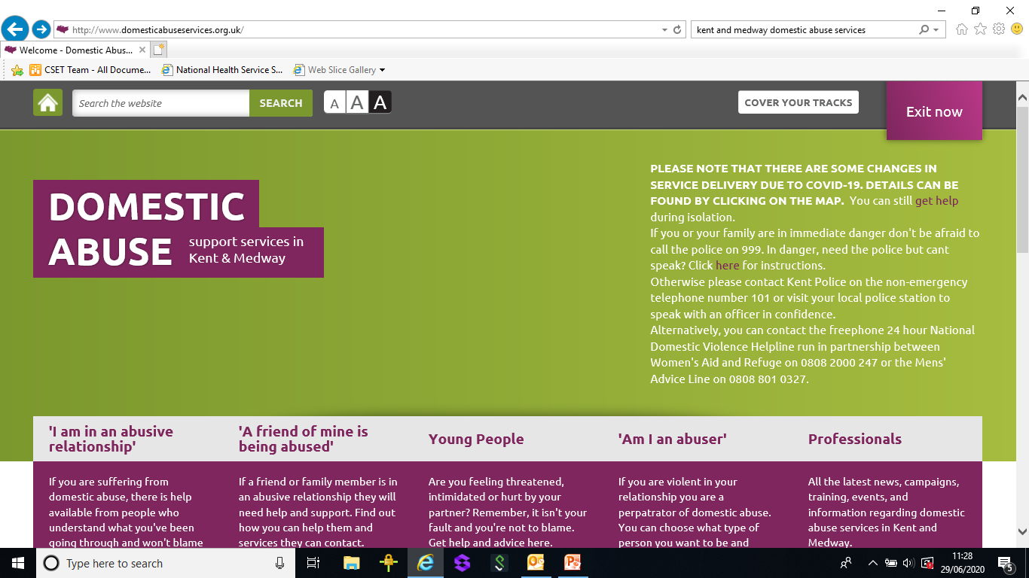
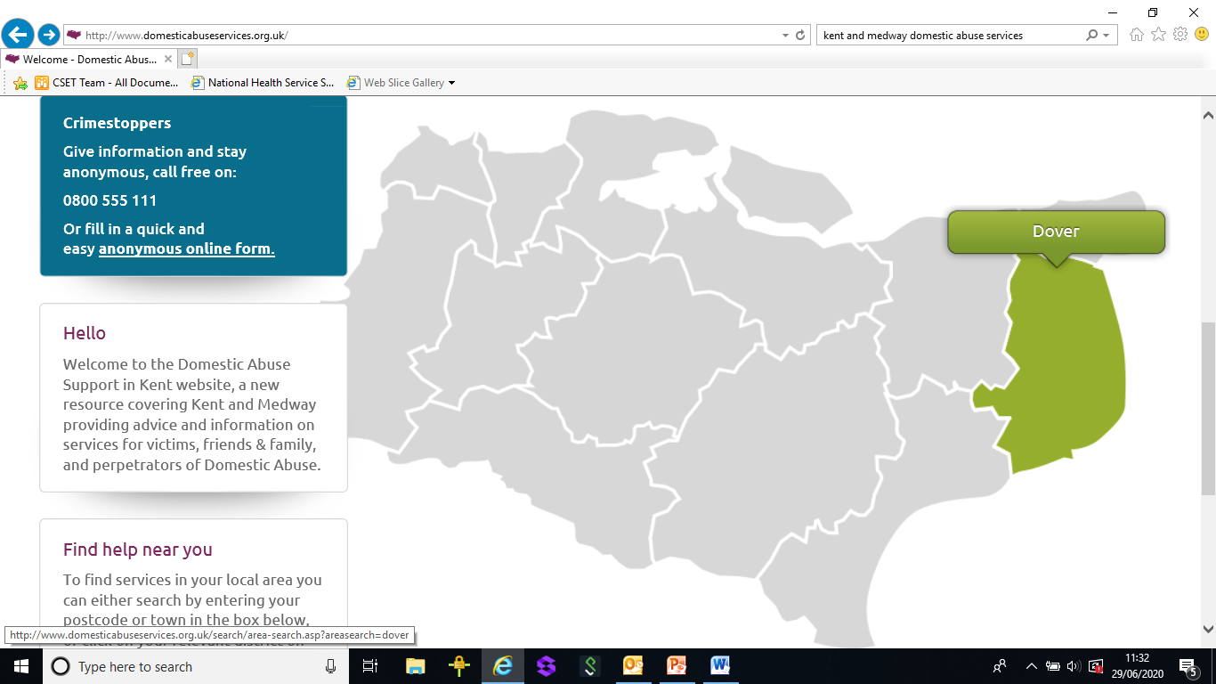
Kent and Medway Domestic Abuse Services
www.domesticabuseservices.org.uk
Notes:
This is the website for professionals or patients/clients can search by postcode or click on district area for recourses in that specific area
Point out the quick exit button
State that this email address doesn’t register in peoples search history

Slide 59
Training Resources
https://www.youtube.com/watch?v=UaJTogQ_YxU&feature=youtu.be
https://www.creativereview.co.uk/refuge-film-lockdown/
Notes:
Top one is for all front line professionals
Bottom clip is about what it would be like in lockdown for a victim of domestic abuse

Slide 60
Domestic Abuse Poster Campaigns
Notes:
Posters that people may see
First one is the Gov one
2nd is Kent Police Poster
3rd is from the commissioned services

Slide 61
LAC Team

Slide 62
Beech House SARC
Kent & Medway
Katy Cawkwell
Advanced Forensic Nurse Practitioner/SARC Manager

Slide 63
Welcome
Who knows what a SARC is?
Who has referred someone to a SARC?

Slide 64
Learning outcomes
To increase our awareness of local
SARC Service
Increase understanding of referral pathways
To increase our professional curiosity around Sexual Assault
Clinical/forensic update

Slide 65
What is SARC?
Sexual Assault Referral Centre's are an important example of how agencies working in partnership have the potential to improve both mental and physical health as well as criminal justice outcomes for victims of rape and sexual assault. Crucially, they provide a holistic service to victims of sexual abuse, tailored to their needs and under-pinned by principles of dignity, belief and respect.

Slide 66
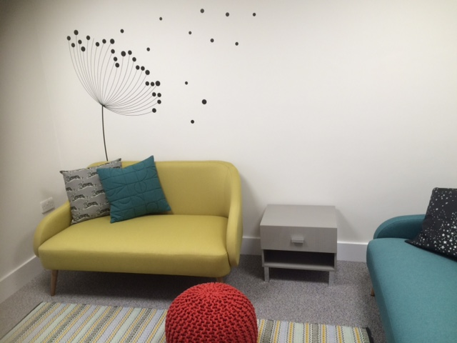
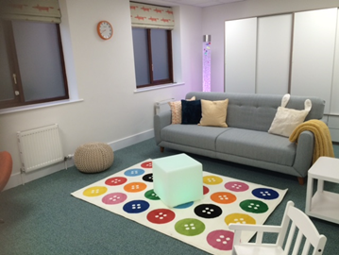
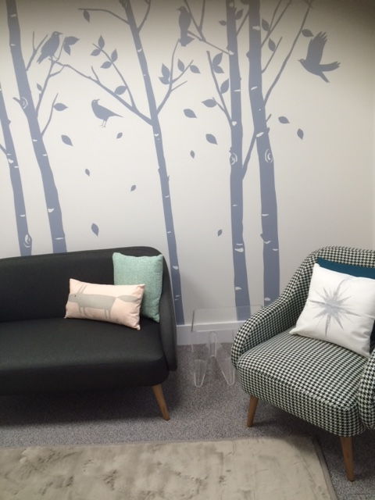
Beech House SARC (Maidstone)
Beech House consist of 3 examination suites; one for, adults, one for children and one for training. The suits consist of a forensic waiting room, forensic examination room and an aftercare room.
We are based off Armstrong Road in Maidstone and there is public transport close by.

Slide 67
Who do we see?
Anyone
Paediatric contract <13’s
Adult contract >13’s
(CSA pathway <18’s)

Slide 68
Accessing Beech House Services
Self referral
Account obtained, examination, forensic samples stored for 2 years, anonymous reporting, aftercare, talking therapies. Onward referrals.
Police referral
Examination, forensic samples obtained, aftercare, talking therapies, onward referrals.

Slide 69
Acute Vs non recent
Acute
Consider:
Forensic time frame
Injuries
Talking therapies/ISVA
Additional needs
Non recent
Consider:
Injuries/scaring
Talking therapies/ISVA
Additional needs
Non sexually active

Slide 70
Rape vs Sexual assault
Rape - A person commits rape if they intentionally penetrate the vagina, anus or mouth of another person with their penis without consent.
Assault by penetration - a person commits assault by penetration if they intentionally penetrate the vagina or anus of another person with a part of the body or anything else, without their consent.
Sexual assault - A person commits sexual assault if they intentionally touch another person, the touching is sexual, and the person does not consent

Slide 71
Basic forensic time frames
Oral penetration = 48 hours
Anal penetration/Penile = 72 hours
Skin = 2 days
7 days (unwashed)
Vaginal =
7 day
Pre pubertal = 72 hours
digital penetration = 48 hours
FFLM guidelines 2020

Slide 72
SARC Journey
Initial stage – information gathering
Medical/forensics (acute vs Non recent)
Aftercare

Slide 73
Summary of the SARC journey
Clients can be at the SARC between 2-5 hours
Forensics may or may not be required
The examination should not be painful
Body mapping of injuries can take place
A colposcope might be used to take images
Aftercare will be offered

Slide 74
Aftercare – What do Beech House offer?
post exposure prophylaxis (PEP)
post coital contraception (PCC) Ella One & Levonelle
Referrals (GUM, SS, DA, Substance misuse, GP, ISVA
Talking therapies pathway
Non-judgmental support & advice
Support literature

Slide 75
Talking therapies pathway
Commissioned by NHSE
Tiered pathway
Specialist counselling
Trauma therapy (EMDR/CBT)
Rapid referral into an acute NHS trust
Rapid access to talking therapies for acute or non recent cases

Slide 76
Differential diagnosis
Genital warts (human papillomavirus – HPV)
Rule out other possibilities; molluscum, skin tag and any other possibilities
If you think the child has genital warts the CSA pathway clearly states there should be a referral made into social care, strategy discussion to take place and a medical examination by SARC.
SARC will complete an examination, refer the child to Maidstone GUM (treatment, STI screen)
If unsure seek a second opinion from a dermatologist or a paediatrician

Slide 77
SARC journey Video

Slide 78
Any Questions?

Slide 79
Thank you for your time
Katy Cawkwell - Advanced forensic Nurse Practitioner/SARC Manager for Kent & Medway
Katy.Cawkwell@mountainhealthcare.co.uk
SARC in hours: 01622 726461
24/7 call centre: 0330 223 1622
Beech House secure email: bh.admin@nhs.net

Slide 80
Healthcare of those with a Learning Disability
Lessons from Covid-19
Lessons from LeDeR
Dr Lynne Wright
Named GP Safeguarding Kent and Medway CCG

Slide 81
LeDeR Learning Disabilities Mortality Review
First national programme of its kind
Started in 2016, last review March 2019:
Female 27yrs, males 23 yrs earlier death
50% deaths reviewed showed good practice
11% raised concerns
8% care so below good practice that either impacted wellbeing or directly contributed to the death.

Slide 82
LeDeR
41% died Pneumonia or aspiration pneumonia
60% have GI malignancy vs 25% in gen. pop.
Cervical screening 31.2% vs 73.2%
Breast 52% vs 68%
Colorectal 79% vs 85%
Dysphagia
Epilepsy
Obesity and underweight

Slide 83
Covid-19 and LD National Data
April 10-May 15 2020: 386 deaths with LD or ? Autism
134% increase on previous year
206 Covid-19 positive

Slide 84
Covid-19 and LD Locally
26 deaths have undergone a rapid review in Kent
62% due to or suspected due to Covid-19

Slide 85
Lessons to be Learnt
Inequality
Screening
Primary care LD reviews
DNACPR
Antibiotic prescribing
Support for carers re palliative care/death

Slide 86
Your feedback for this Virtual PLT: Safeguarding and remote consultations
Please click the below link to provide your feedback which will then produce your certification for attendance
https://www.eastkenttraininghub.org/plt-evaluation-july-2020

