Slide 1
Looked After Children
GP PLT training sessions
July 2020
Kent and Medway CCG Looked After Children’s Team

Slide 2
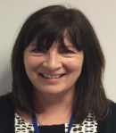
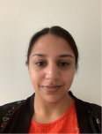
Our team
Dr Sue Leather- Designated Doctor for Looked After Children susan.leather@nhs.net / 07557212993 | Nancy Sayer- Designated Consultant Nurse for Looked After Children nancy.sayer@nhs.net / 07920278148
Dr Khadija Himid- Deputy Designated Doctor for Looked After Children (Starting July 2020) | Vacant post- Deputy Designated Doctor for Looked After Children
Vacant post- Deputy Designated Doctor for Looked After Children | Roxanne Hills- Deputy Designated Nurse for Looked After Children roxanne.hills@nhs.net / 07776178074
Paul Haith- Deputy Designated Nurse for Looked After Children paul.haith1@nhs.net / 07880154250 | Vacant post- Deputy Designated Nurse for Looked After Children
Naomi Finch- Project Lead for Looked After Children naomifinch@nhs.net / 07775033178 | Sue McMillan- Business Assistant for Looked After Children susan.mcmillan5@nhs.net / 07585883020
Kirren Sandhu- Business Assistant for Looked After Children kirren.sandhu1@nhs.net / 01634 335075
Team inboxes
Kent: kmccg.ccglacenquiries@nhs.net Medway: kmccg.lac@nhs.net

Slide 3
Who are looked after children?
0-18 years old
Why they become ‘looked after’
Out of area placements
National picture:
England: 78,150 looked after children
Local picture
Kent: 1,358 looked after children
Medway: 424 looked after children

Slide 4
Who are not looked after children?
Special guardianship orders
Adoption
Private fostering
Private fostering team contact details:
For children living in Kent, the Kent County Council private fostering team can be contacted on: 03000 411111
For children living in Medway, the Medway Council private fostering team can be contacted on: 01634 335 726 or privatefostering@medway.gov.uk

Slide 5
Legal basis
Voluntary care/ section 20 of The Children’s Act 1989
Care orders
Emergency Protection Orders
On remand

Slide 6
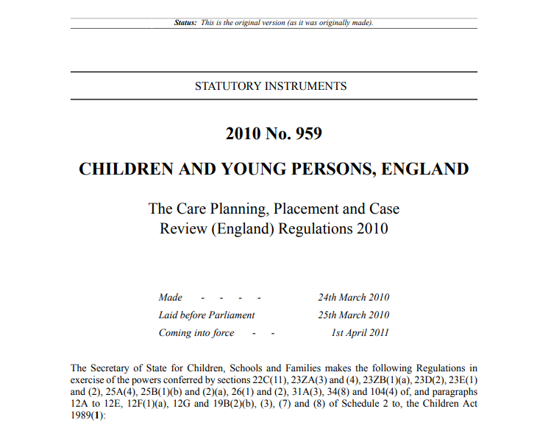
Relevant key guidance

Slide 7
Statutory guidance
Looked after children should never be denied a service because of the location or length of their placement
Looked after children should always be registered (permanently as far as possible) with a GP and have access to a dentist
Many people have a part to play in promoting the health of looked after children
Mental health is as important as physical health
Cooperation and communication are key to improving health outcomes
The voice of the child is at the centre of what we do

Slide 8
The health of looked after children
They consistently have poorer health than young people who have not been in care
Two thirds of looked after children have been found to have at least one physical health complaint
Almost half have a diagnosable mental health disorder, compared with 1:10 of the general population
11% reported to be on the Autistic Spectrum
Many have developmental disorders

Slide 9
Statutory health assessments
Initial health assessments- completed within 20 working days of a child coming into care and completed by a Paediatrician
Review health assessments for those children aged under 5 years old- completed every 6 months by a Specialist Looked After Children’s Nurse
Review health assessments for those aged 5-18 years- completed annually by a Specialist Looked After Children’s Nurse
Health histories- provided to all care leavers by their 18th birthday

Slide 10
Primary care responsibilities
Looked after children should always permanently be registered with a GP
Named GP
Ensure timely access to a GP or other health professional when required
Provide summaries of the health history
Maintain a record of the health assessment
Contribute to the health action plan
Ensure the GP- held clinical record is maintained, updated and remains the main health record
‘Fast-track’ the transfer of records when a looked after child moves to a new GP practice

Slide 11
Useful contacts:
Kent and Medway CCG Looked After Children’s team:
Kent: kmccg.ccglacenquiries@nhs.net
Medway: kmccg.lac@nhs.net
Kent Community Health Foundation Trust Looked After Children’s Team:kcht.vsklacinitial@nhs.net
Medway Community Health Looked After Children’s Team: medch.lac@nhs.net

Slide 12
Relevant guidance
Promoting the health and wellbeing of looked after children (2015): https://assets.publishing.service.gov.uk/government/uploads/system/uploads/attachment_data/file/413368/Promoting_the_health_and_well-being_of_looked-after_children.pdf
Looked after children: Knowledge, skills and competences of health care staff (2015): https://www.rcpch.ac.uk/sites/default/files/Looked_after_children_Knowledge__skills_and_competence_of_healthcare_staff.pdf
NICE guidance: Looked After Children (2015): https://www.nice.org.uk/guidance/ph28
Who Pays? Determining responsibility for payments to providers (2013): https://www.england.nhs.uk/wp-content/uploads/2014/05/who-pays.pdf
Improving mental health support for our children and young people (2017): https://www.scie.org.uk/children/care/mental-health/report

